Slide 1
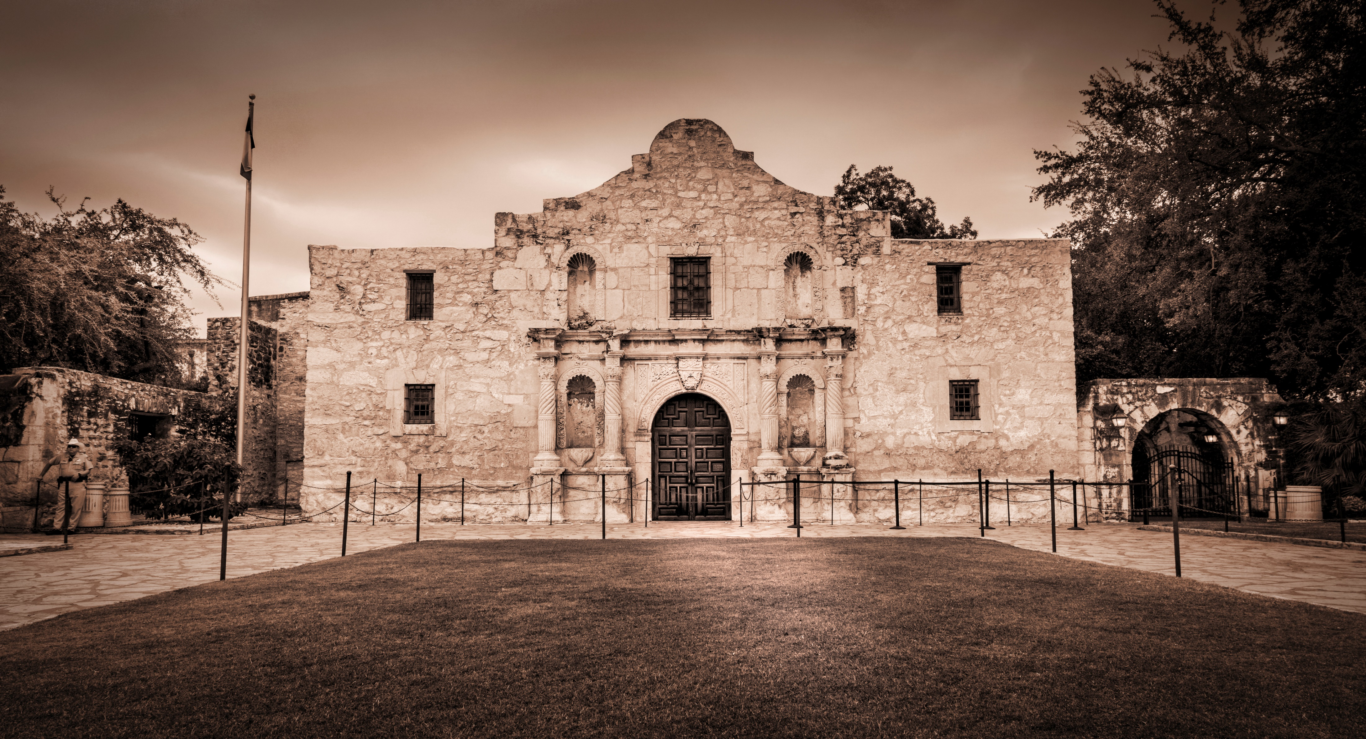

Notes:
1

Slide 2
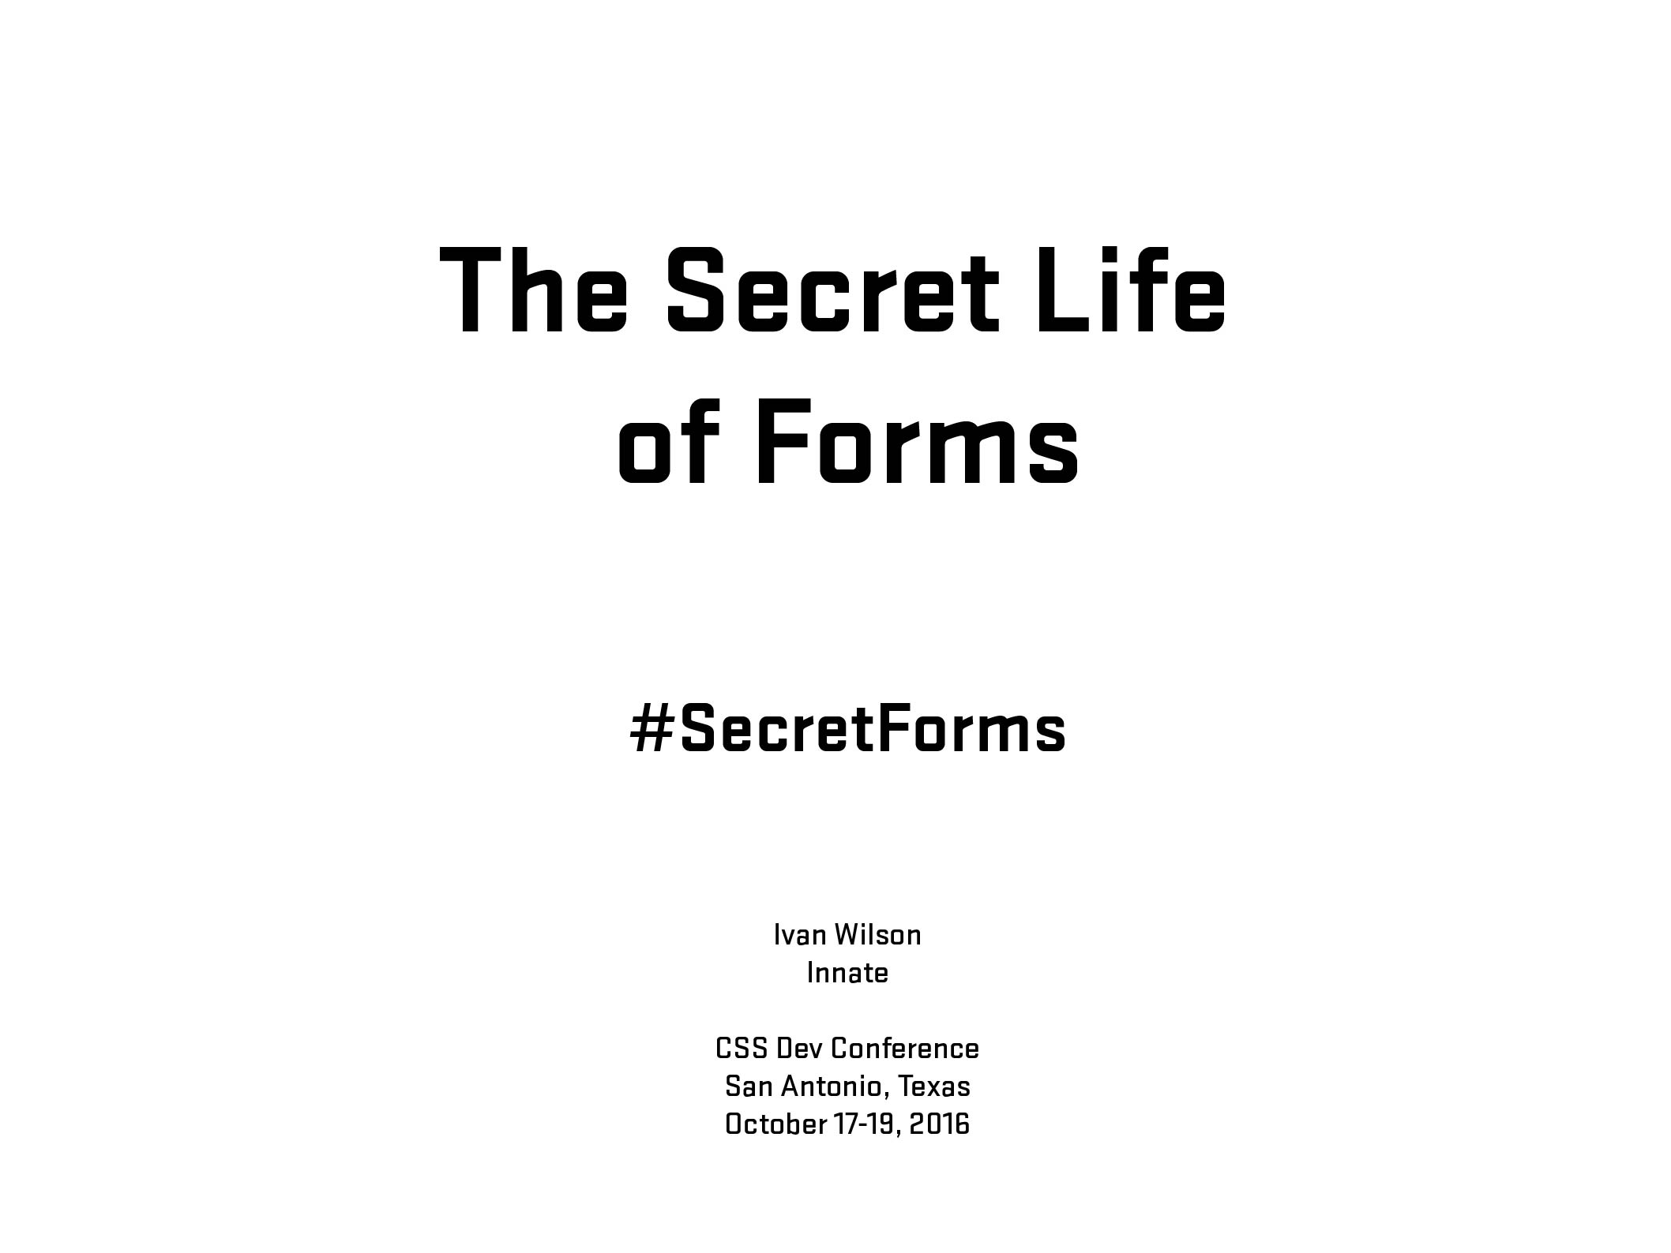
Notes:
2
2
Greetings/additional statements - Title

Slide 3
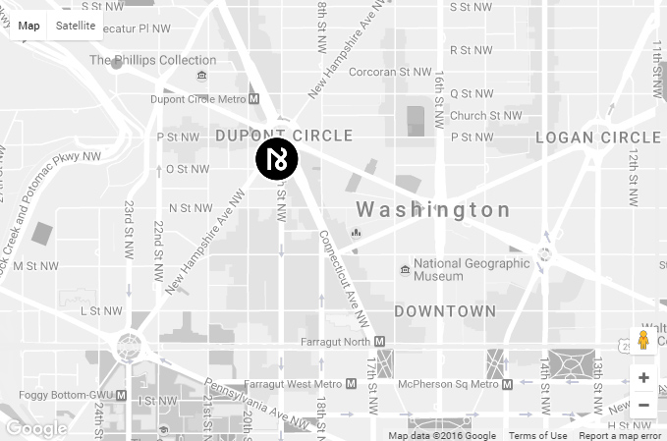

Notes:
3
(Innate location) In Washington, DC (national capital) in Dupont Circle district
3

Slide 4
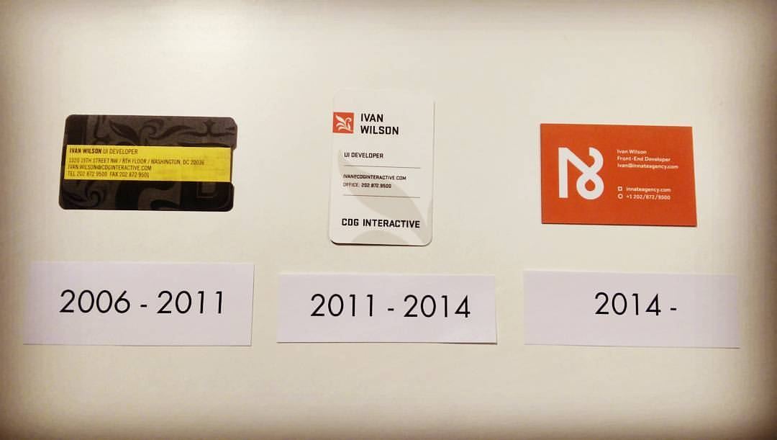
Notes:
4
4
10th Anniversary in April

Slide 5
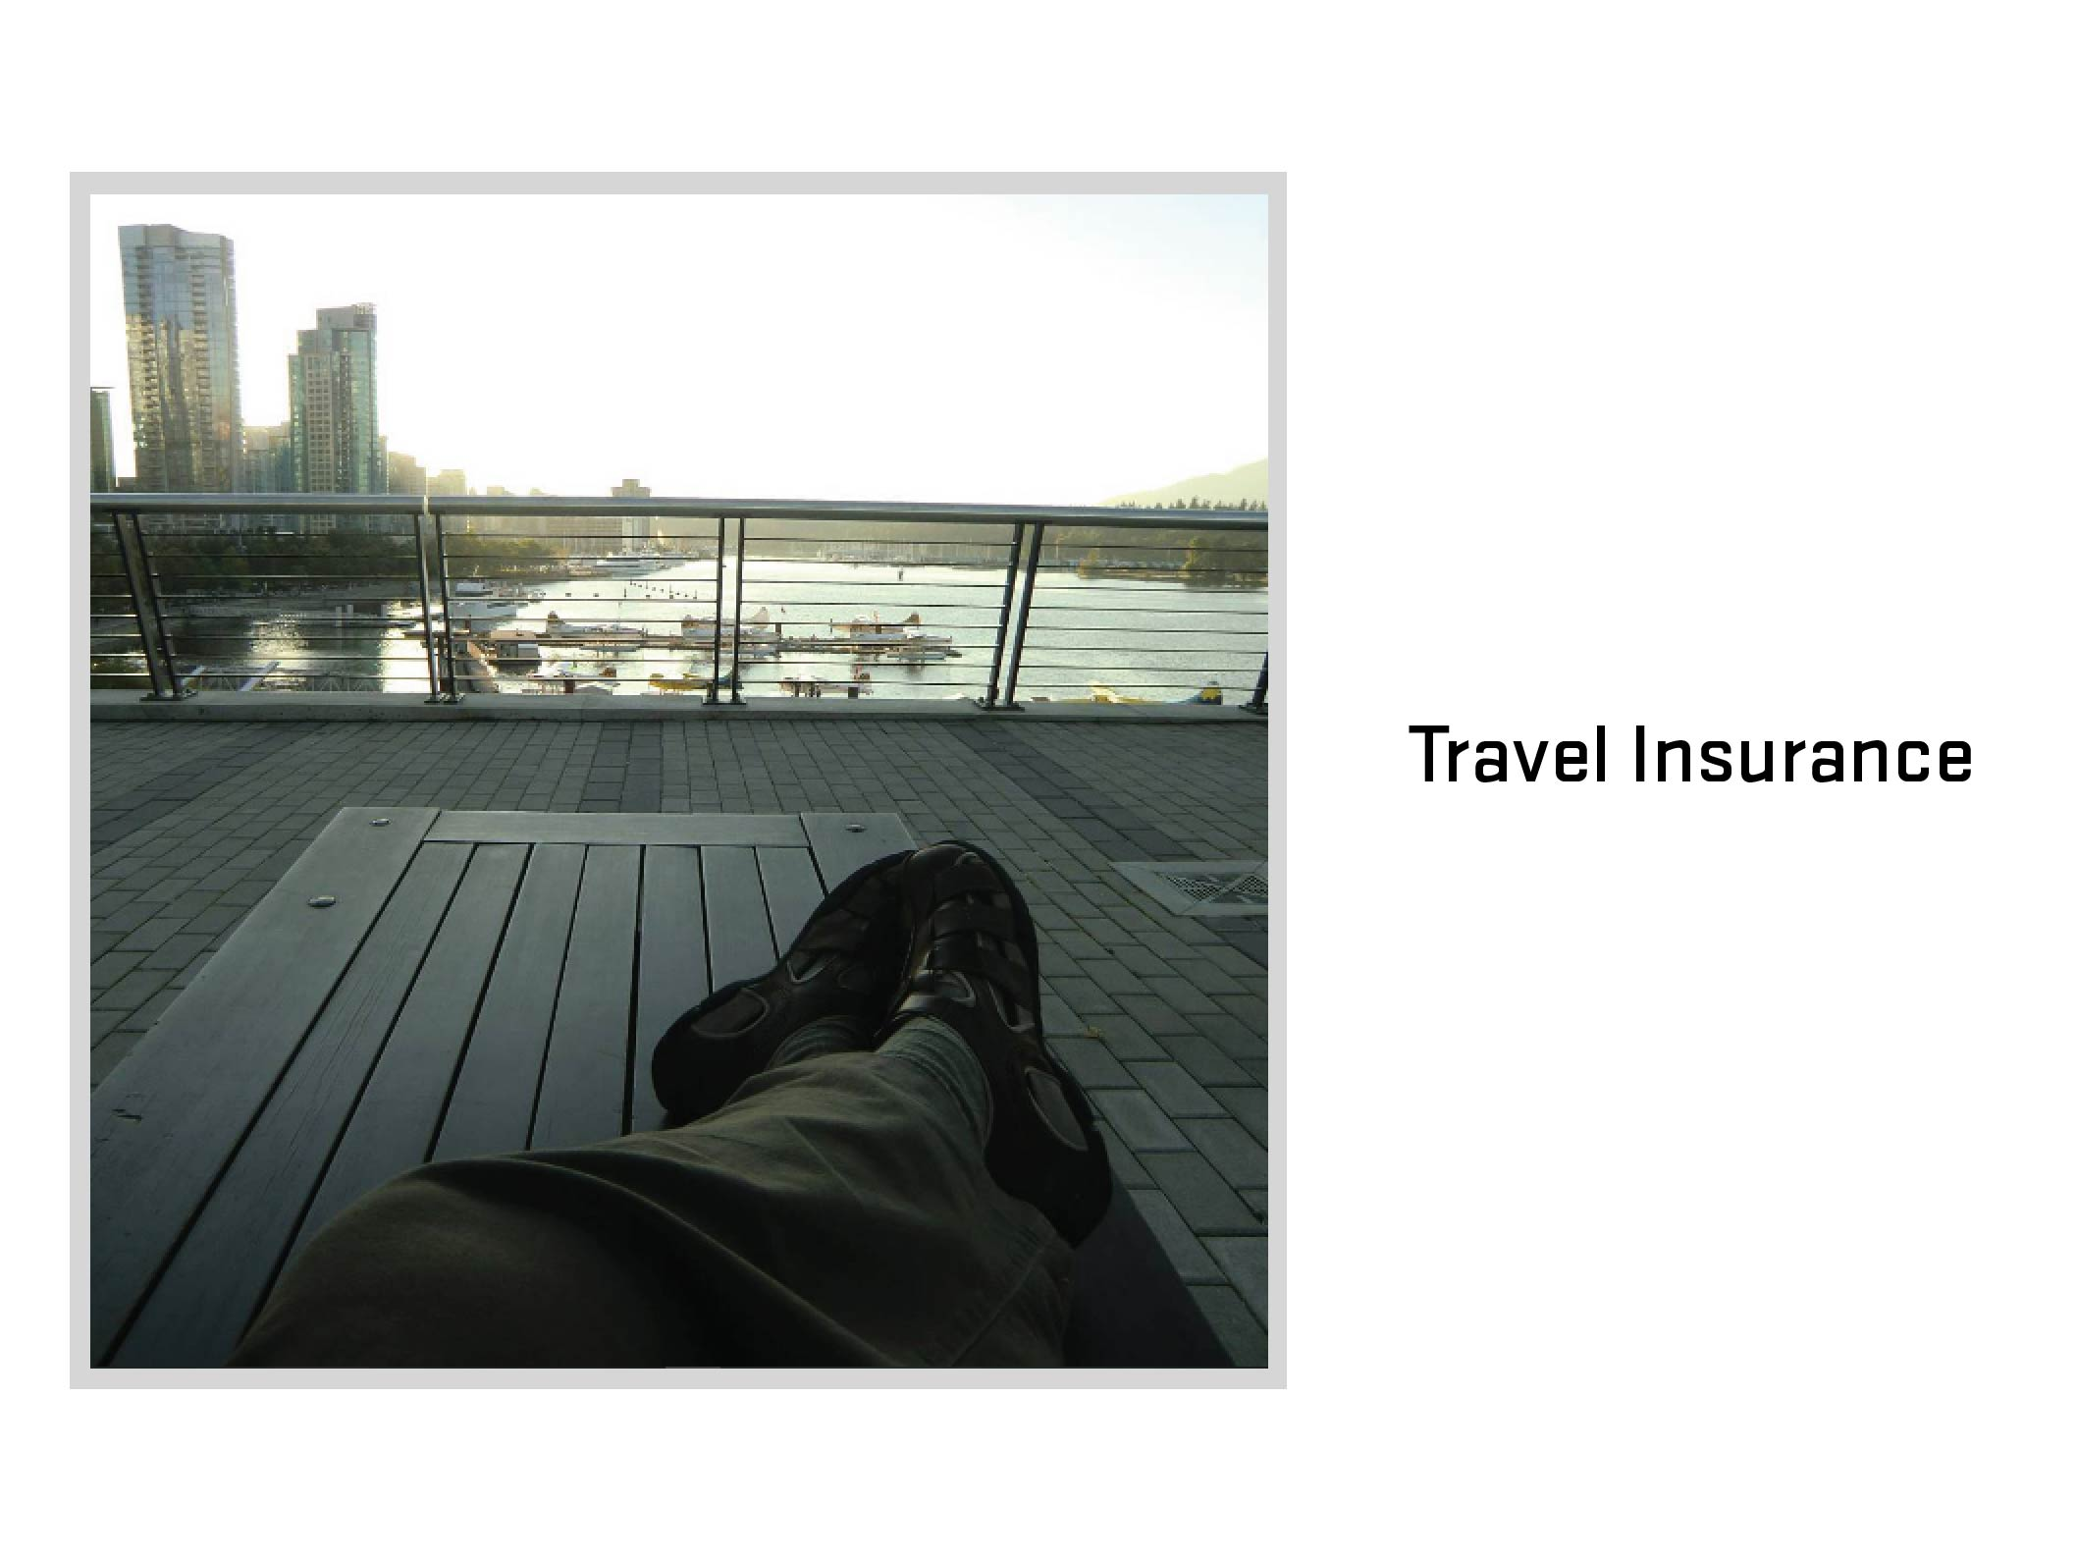
Notes:
5
5
Travel Insurance
What is travel insurance? (Ask audience)

Slide 6
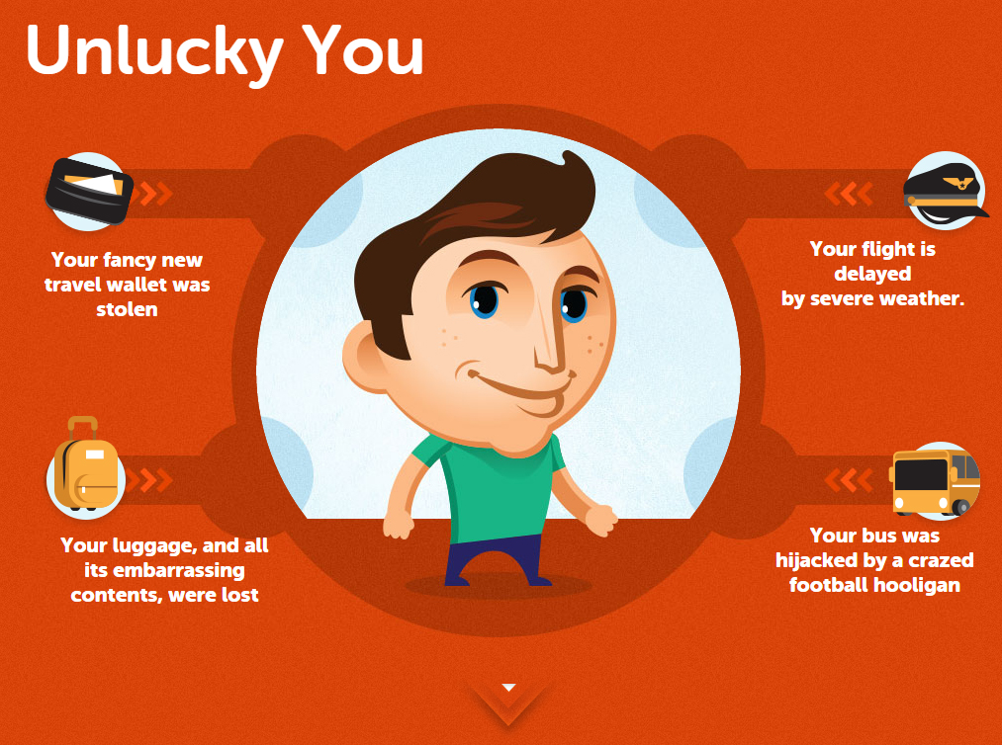
Notes:
6
6

Slide 7
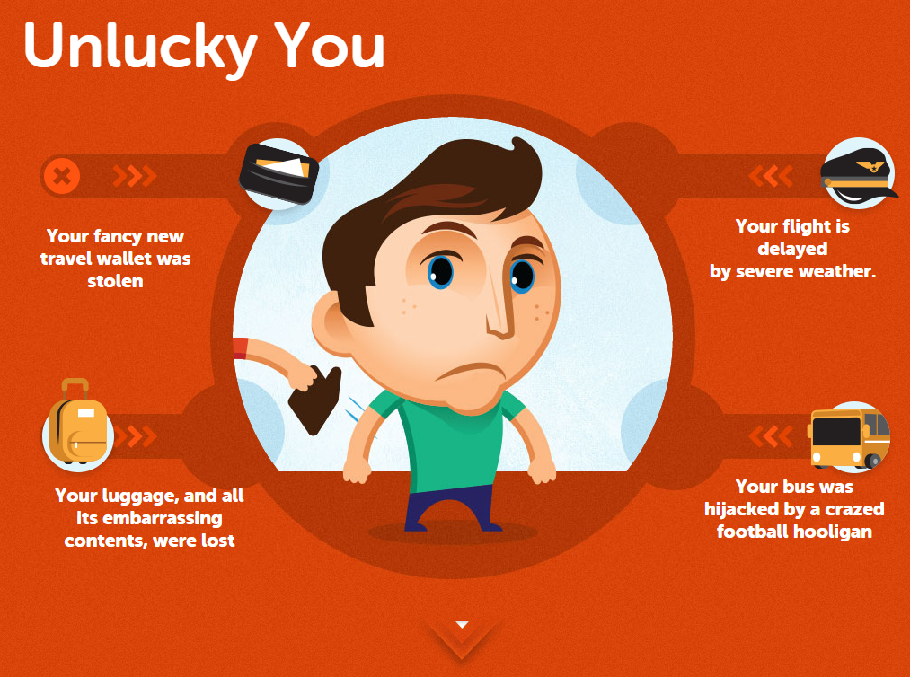
Notes:
7
7

Slide 8
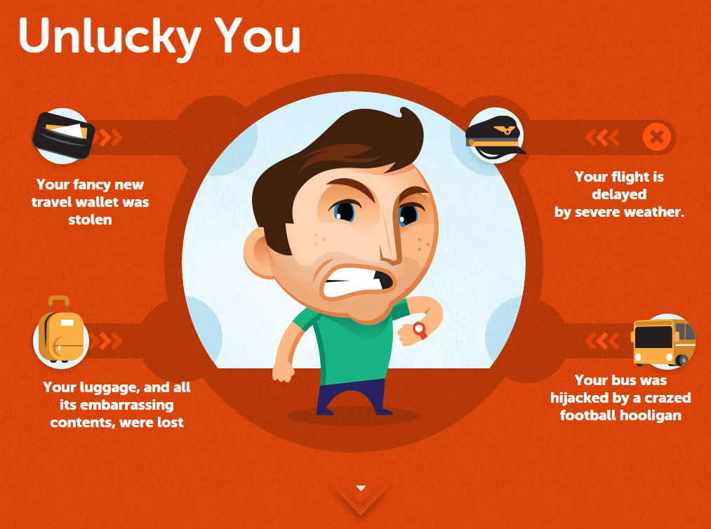
Notes:
8
8

Slide 9
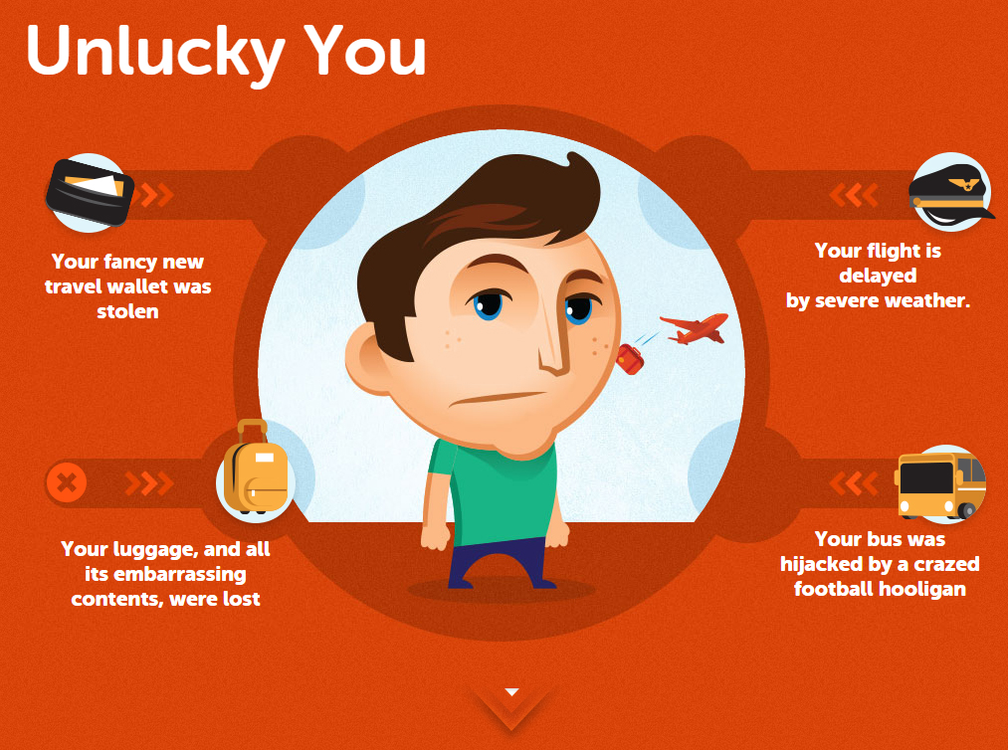
Notes:
9
9

Slide 10
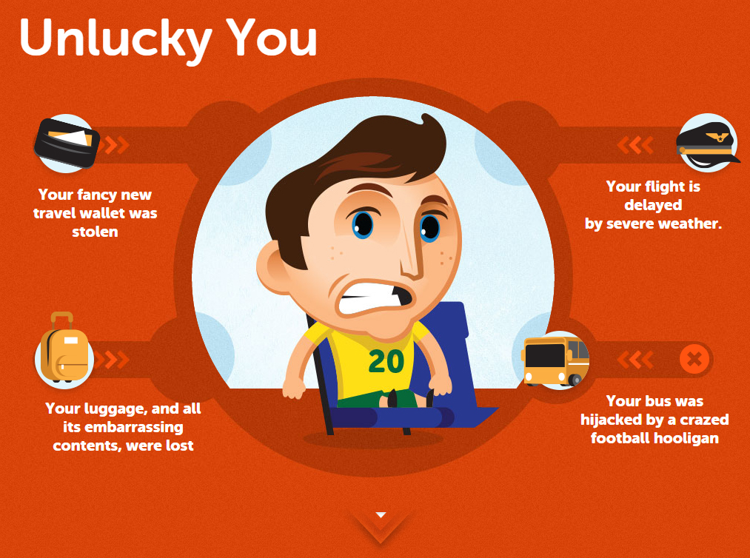
Notes:
10
10

Slide 11
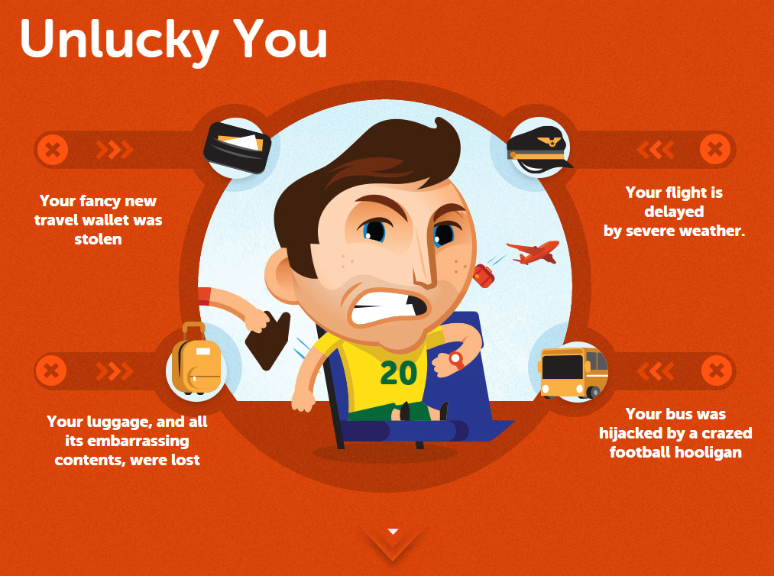
Notes:
11
11

Slide 12

Notes:
12
12

Slide 13
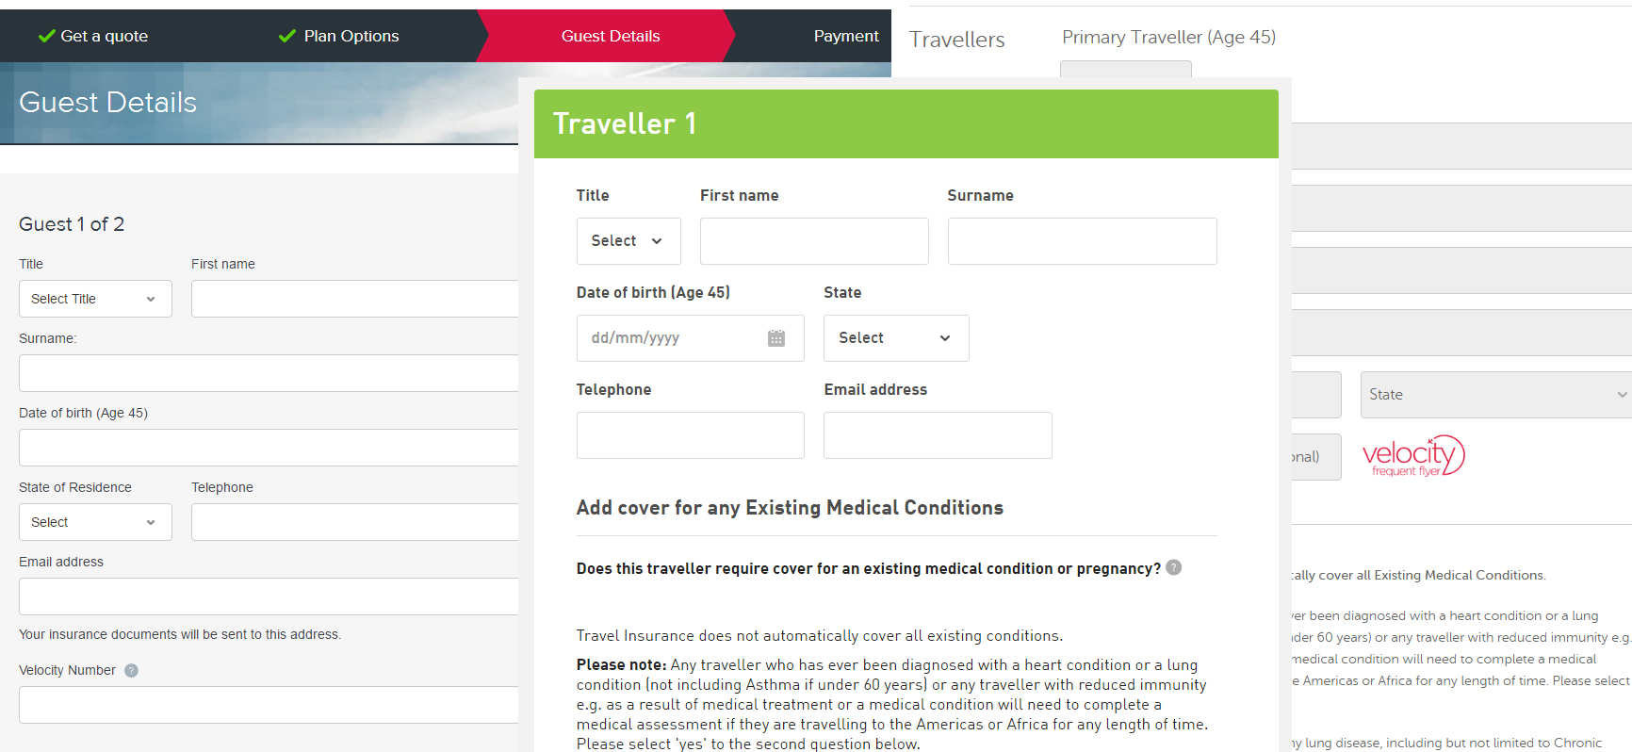
Notes:
13
13

Slide 14
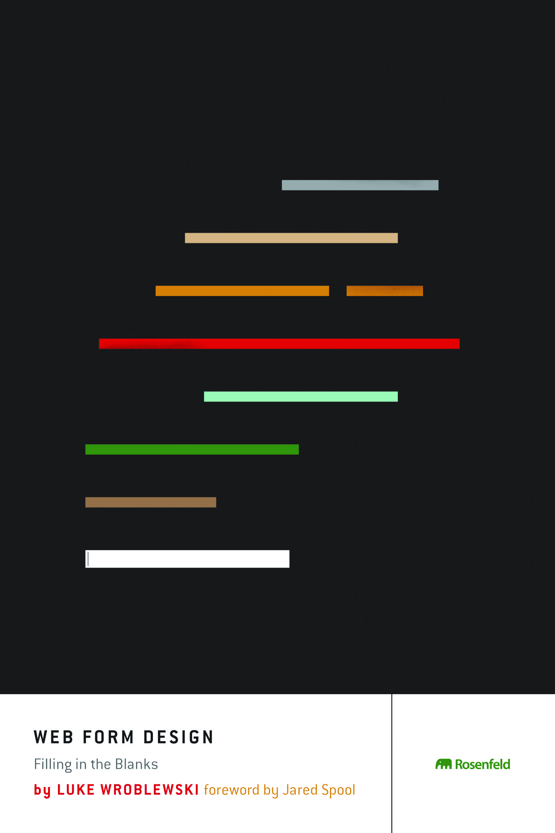
Notes:
14
14

Slide 15
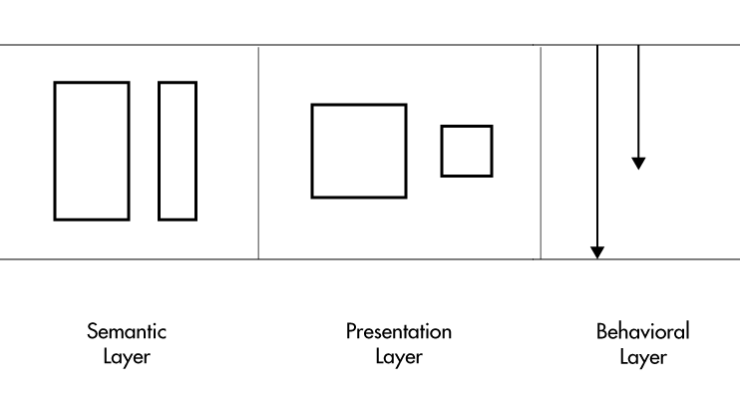
Notes:
15
15

Slide 16

Notes:
16
16

Slide 17
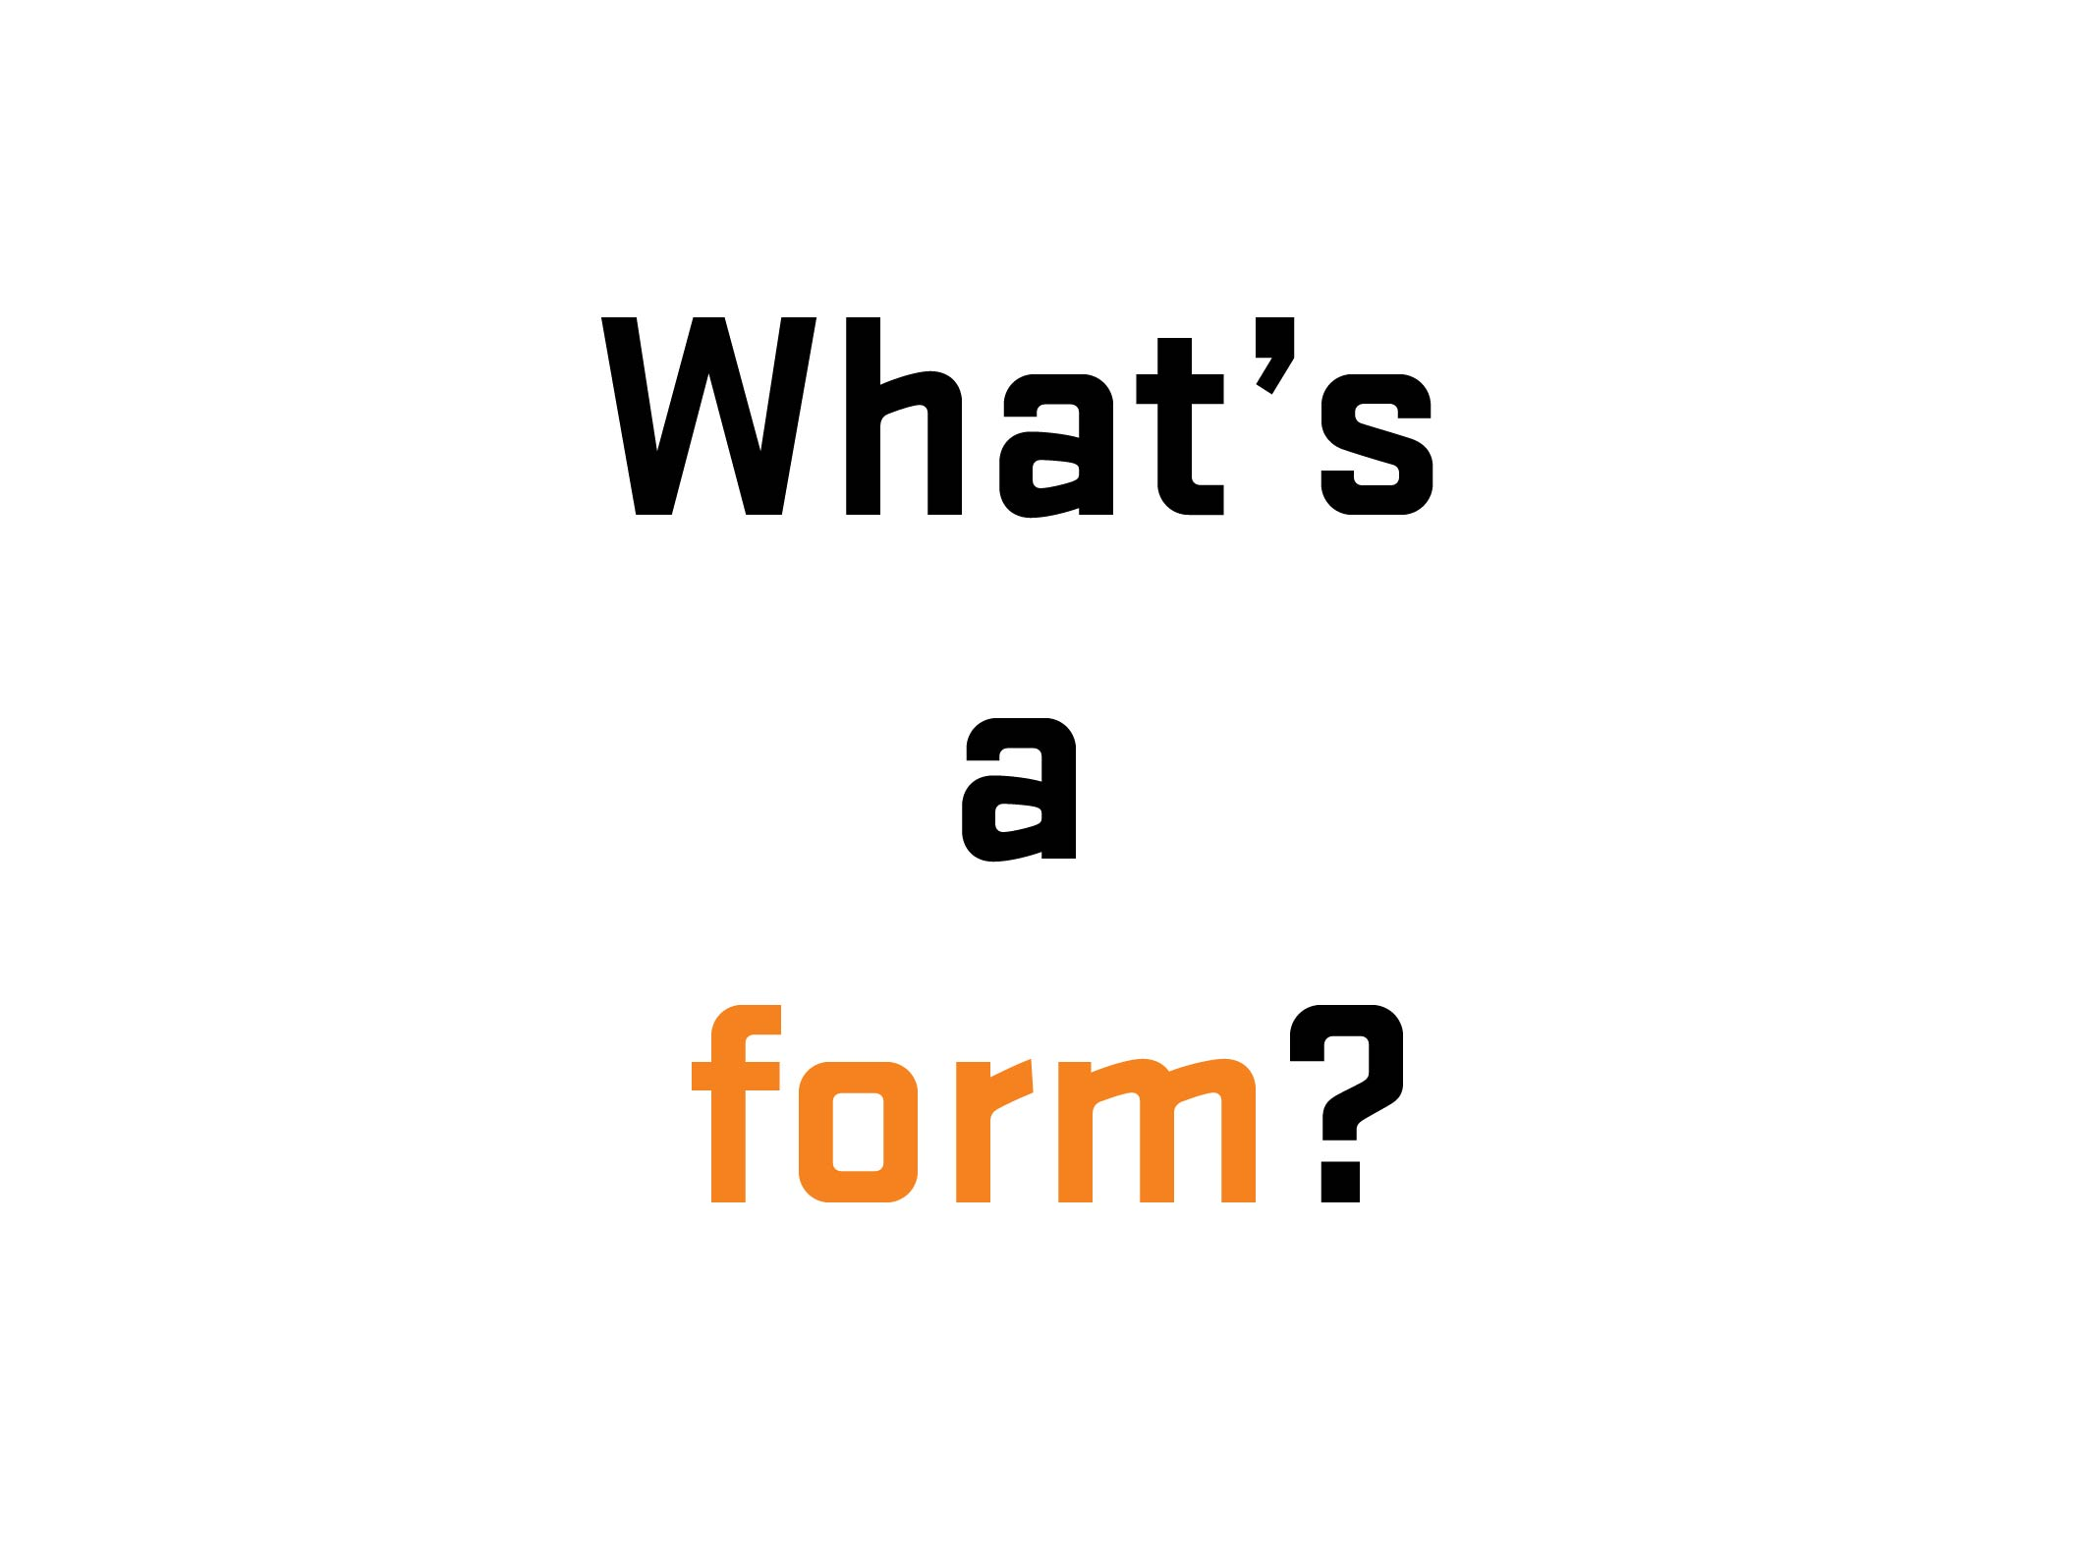
Notes:
17

Slide 18
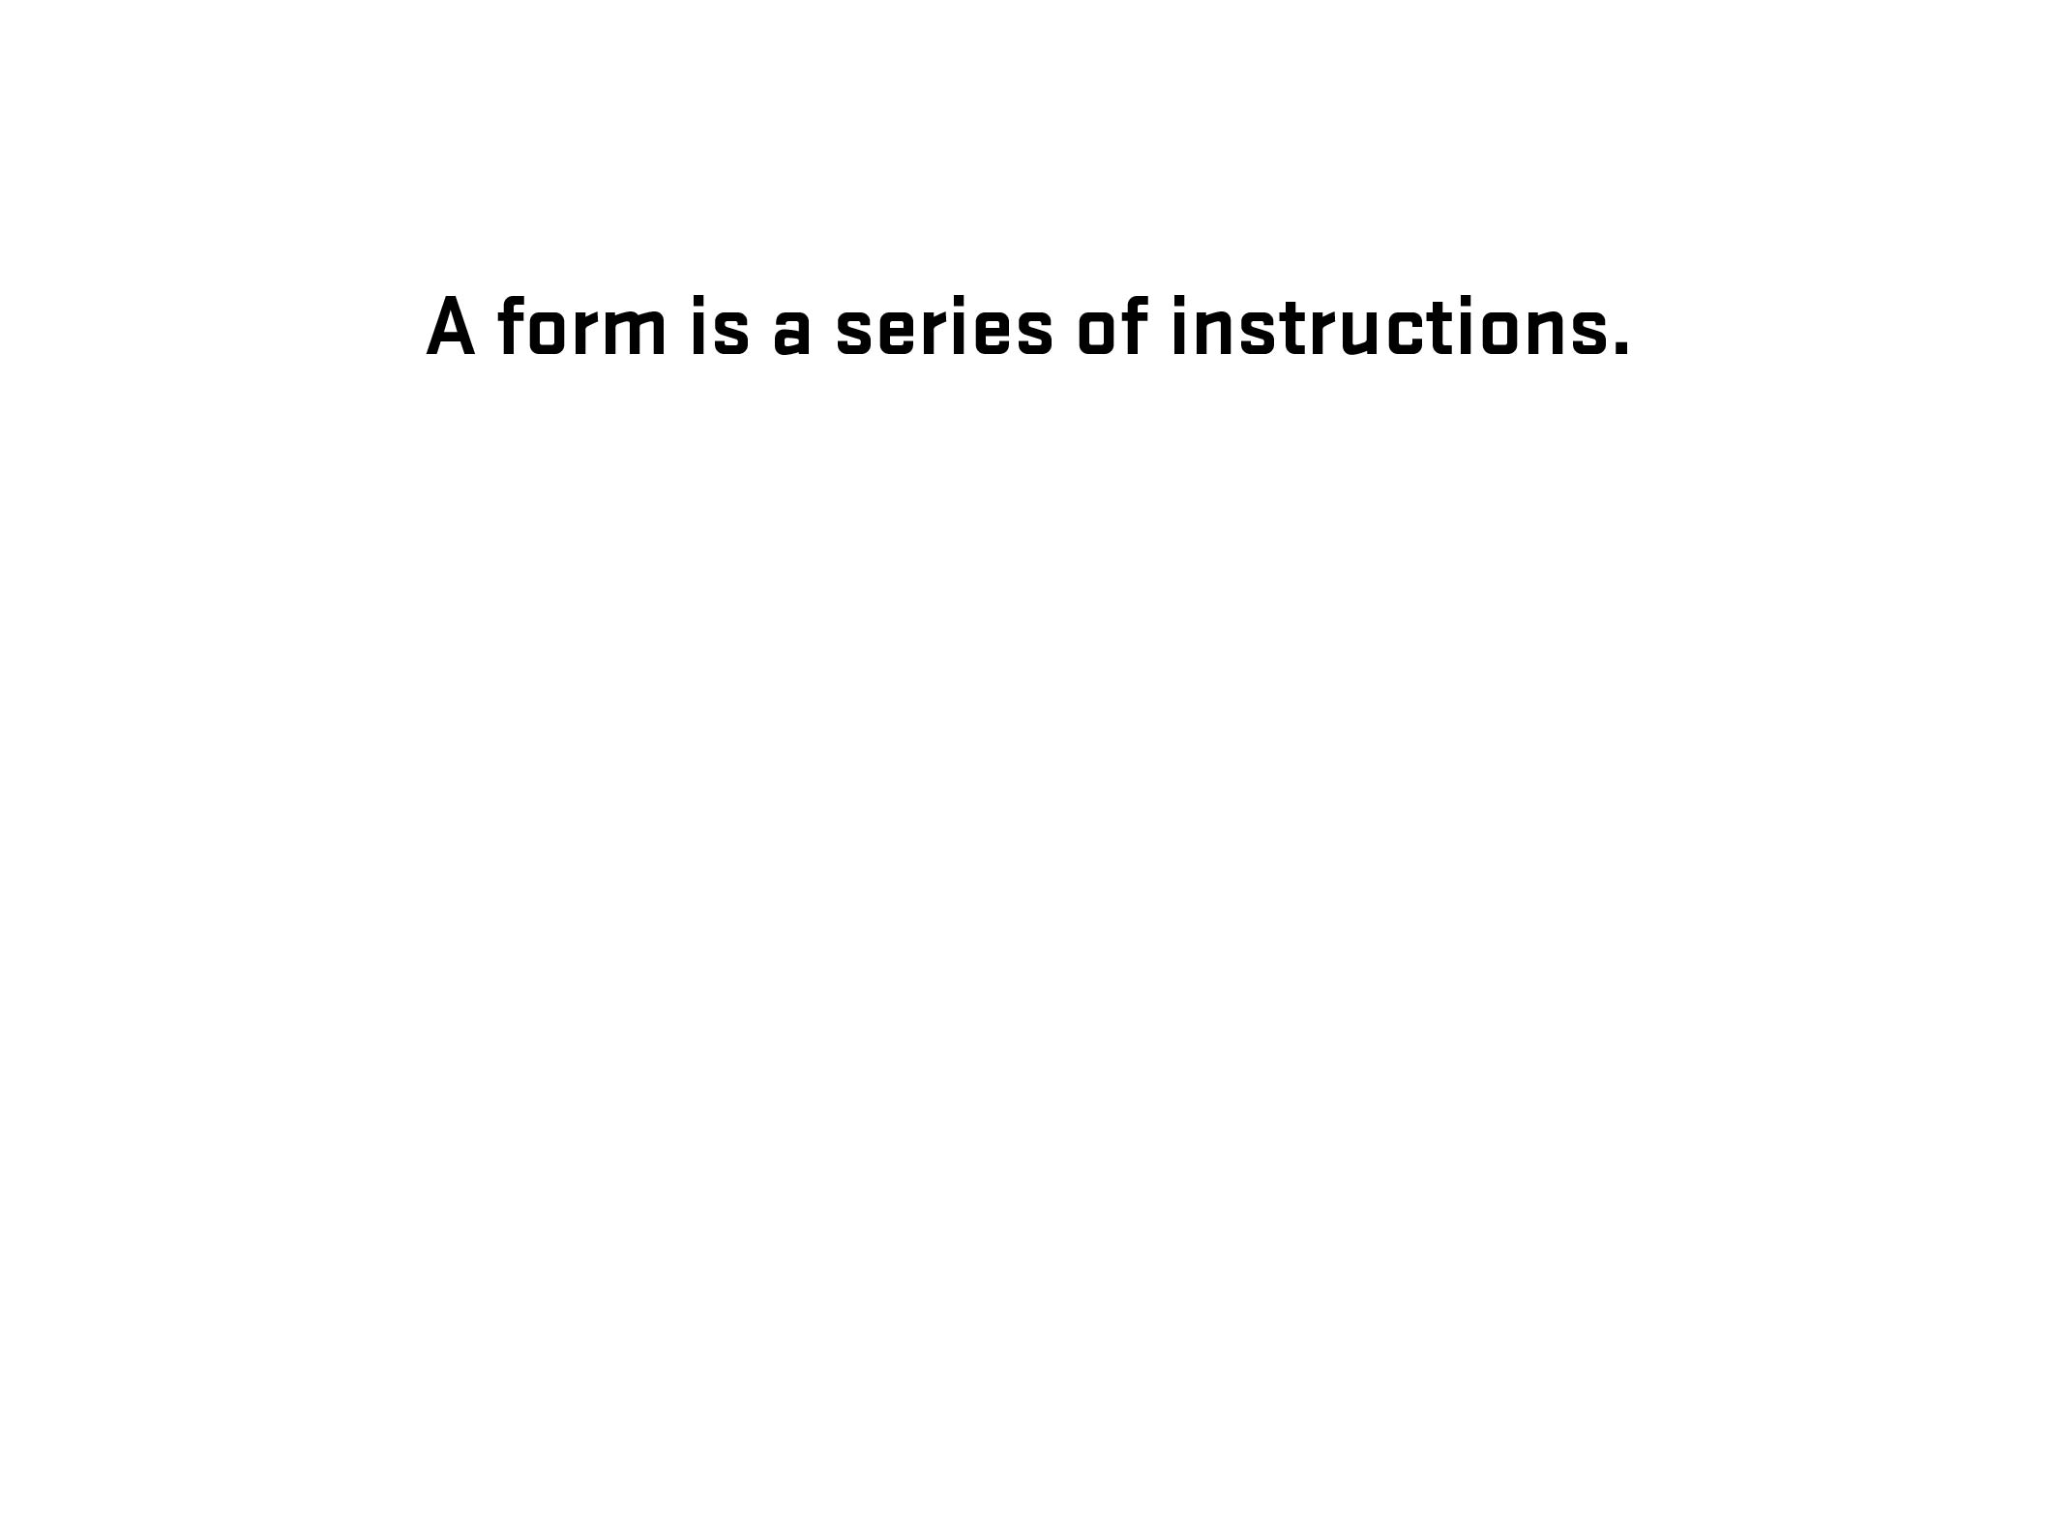
Notes:
18

Slide 19
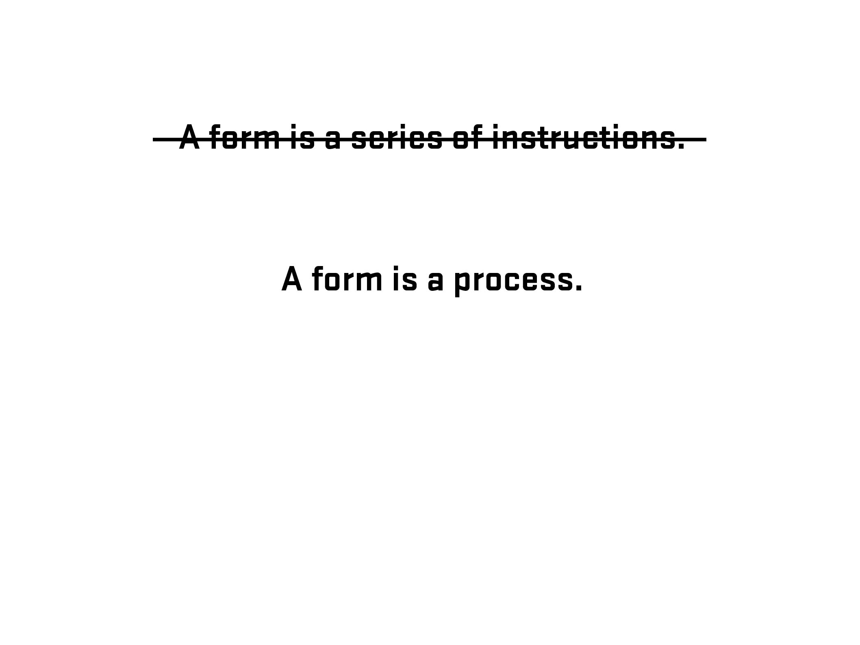
Notes:
19

Slide 20
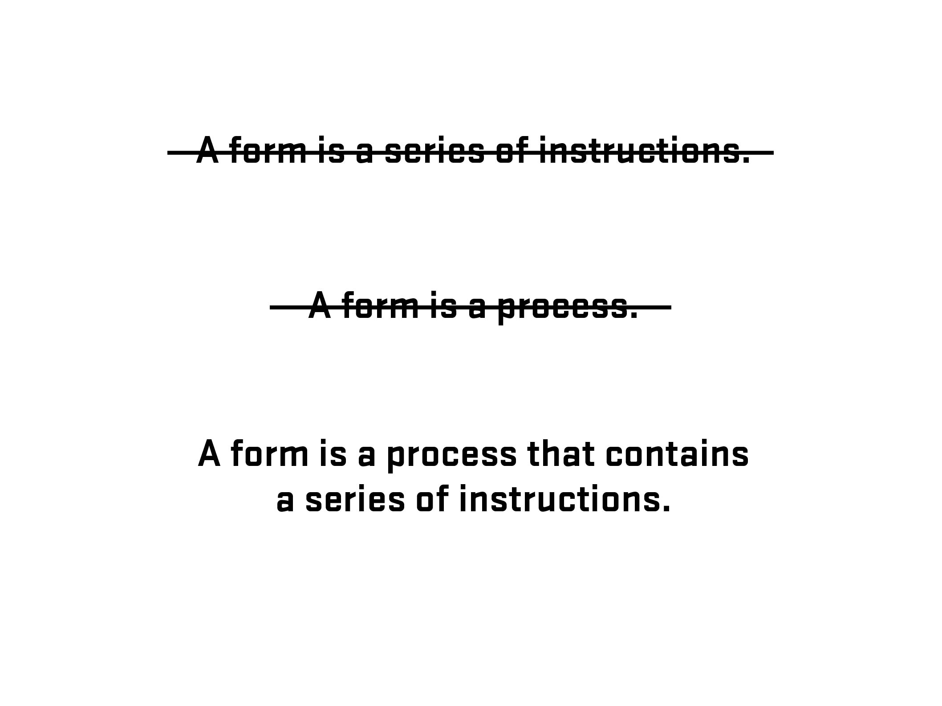
Notes:
20

Slide 21
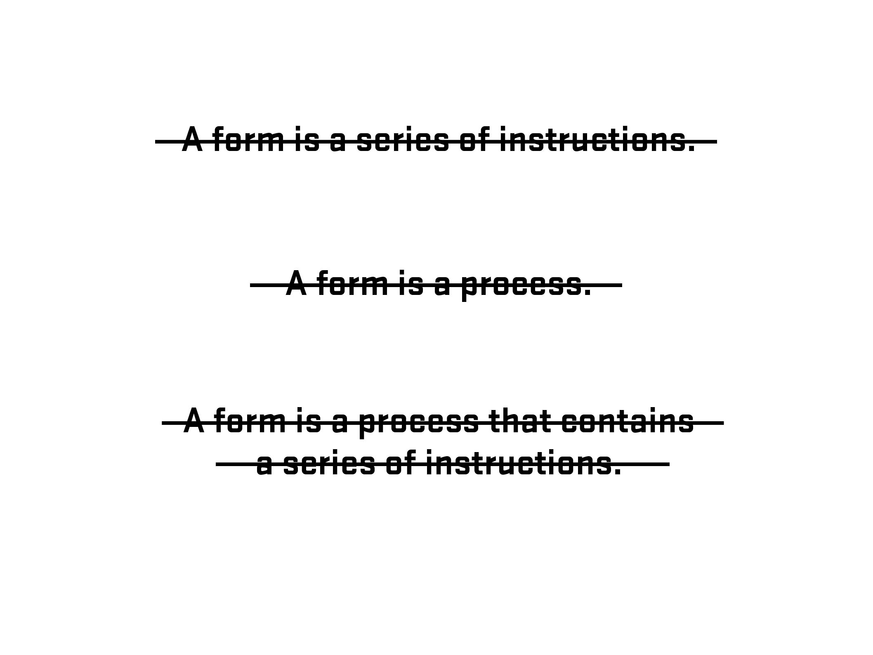
Notes:
21

Slide 22
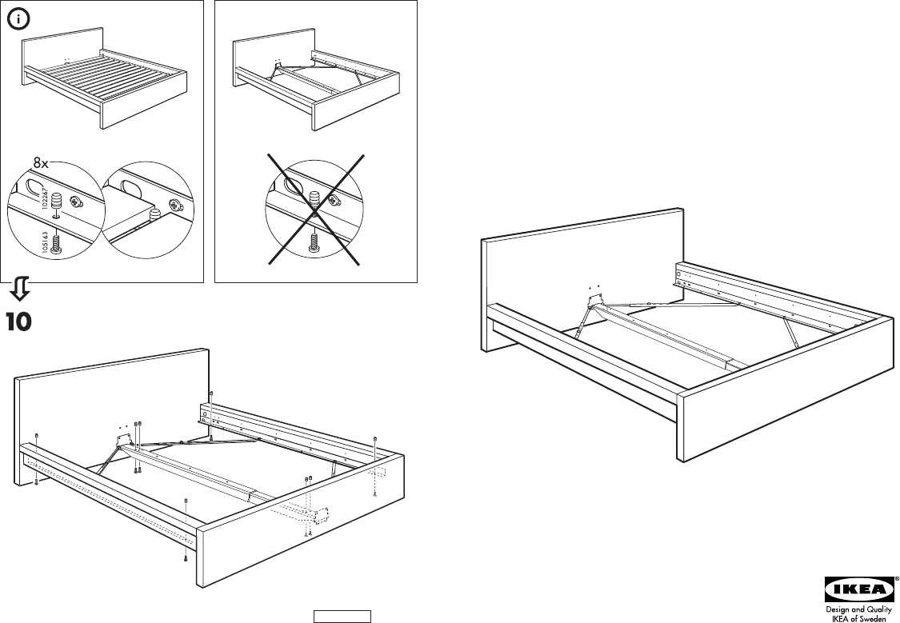
Notes:
22

Slide 23

Photo – Space Lab, Vancouver, Canada (Clint Moroz)
Notes:
23

Slide 24
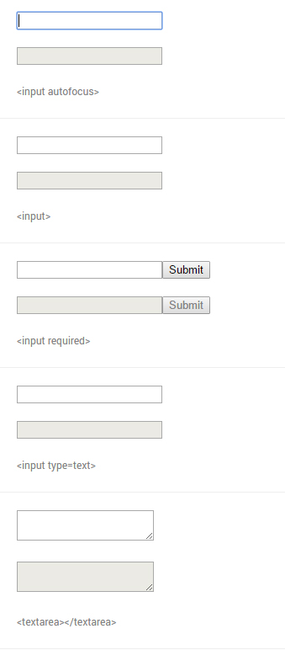
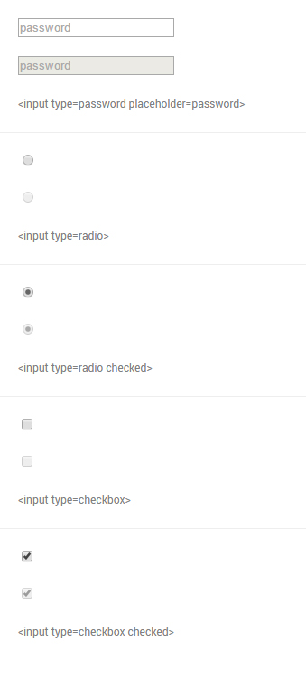
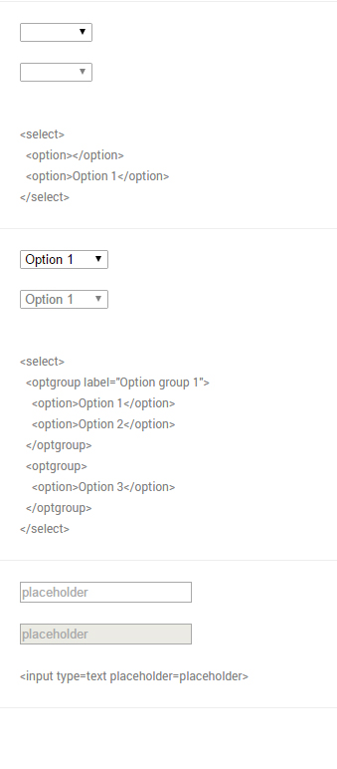
From Native form elements (http://nativeformelements.com/) - Joshua Jenkins
Notes:
24

Slide 25
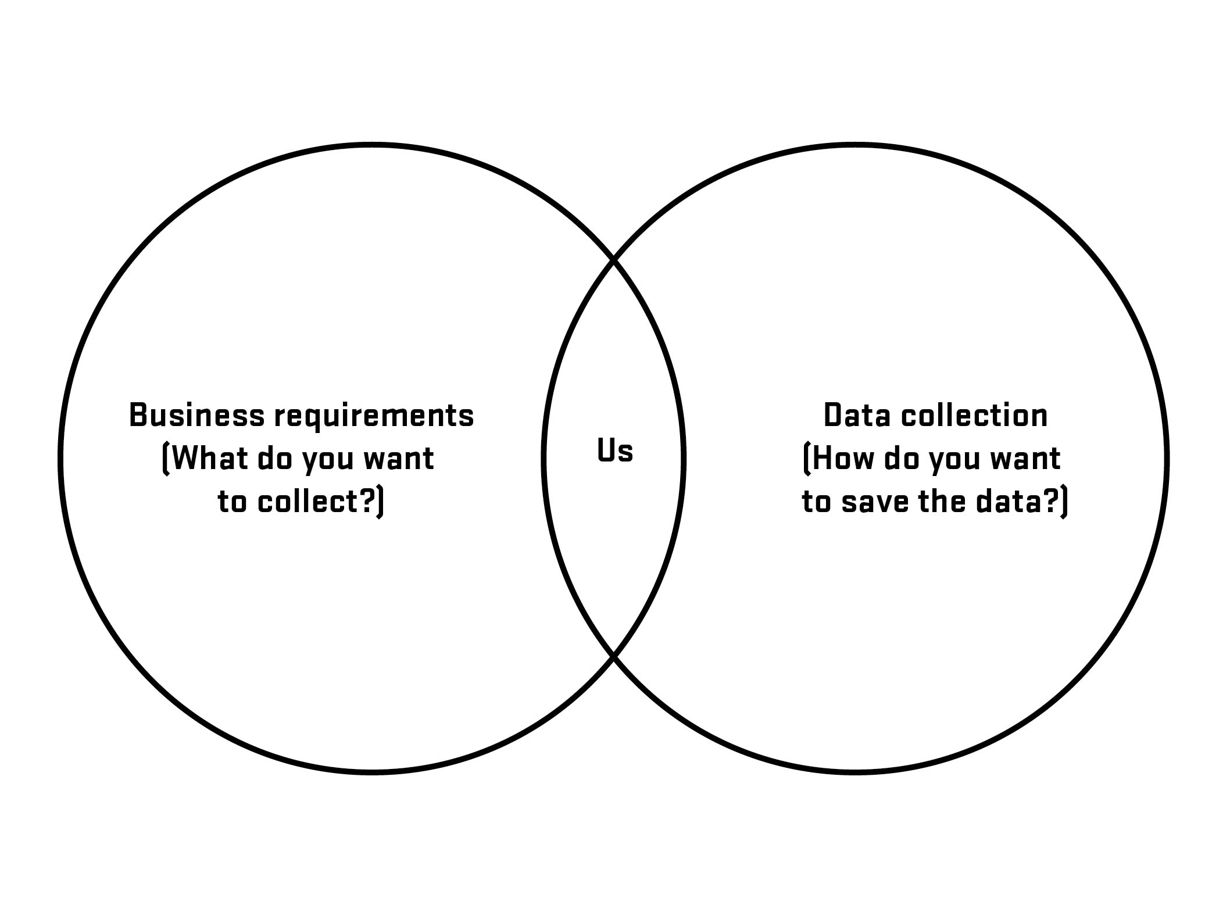

Slide 26
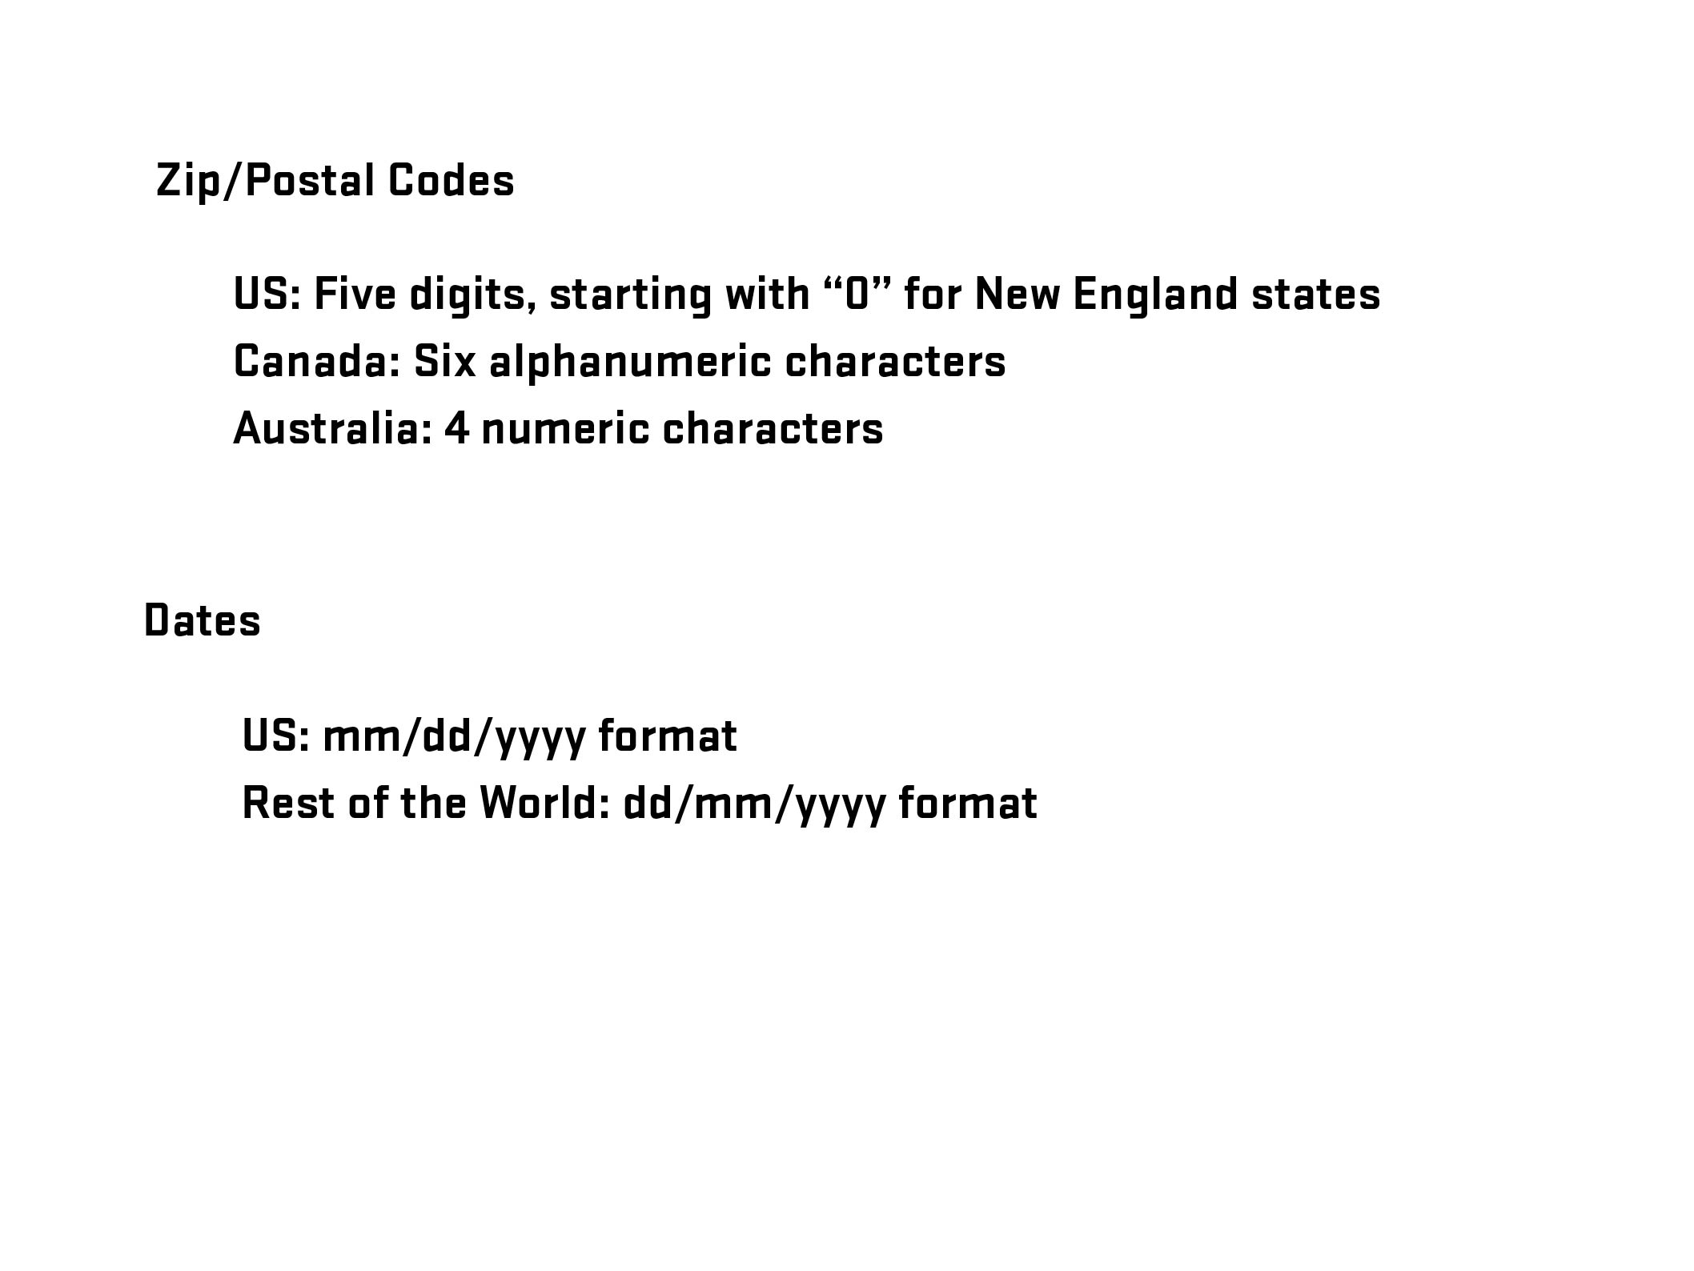

Slide 27
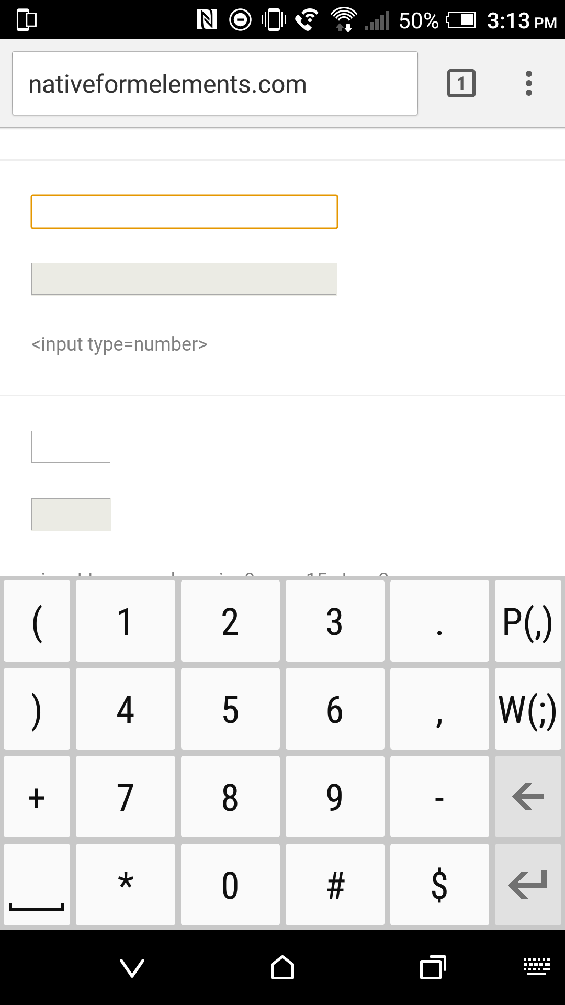

Notes:
27

Slide 28
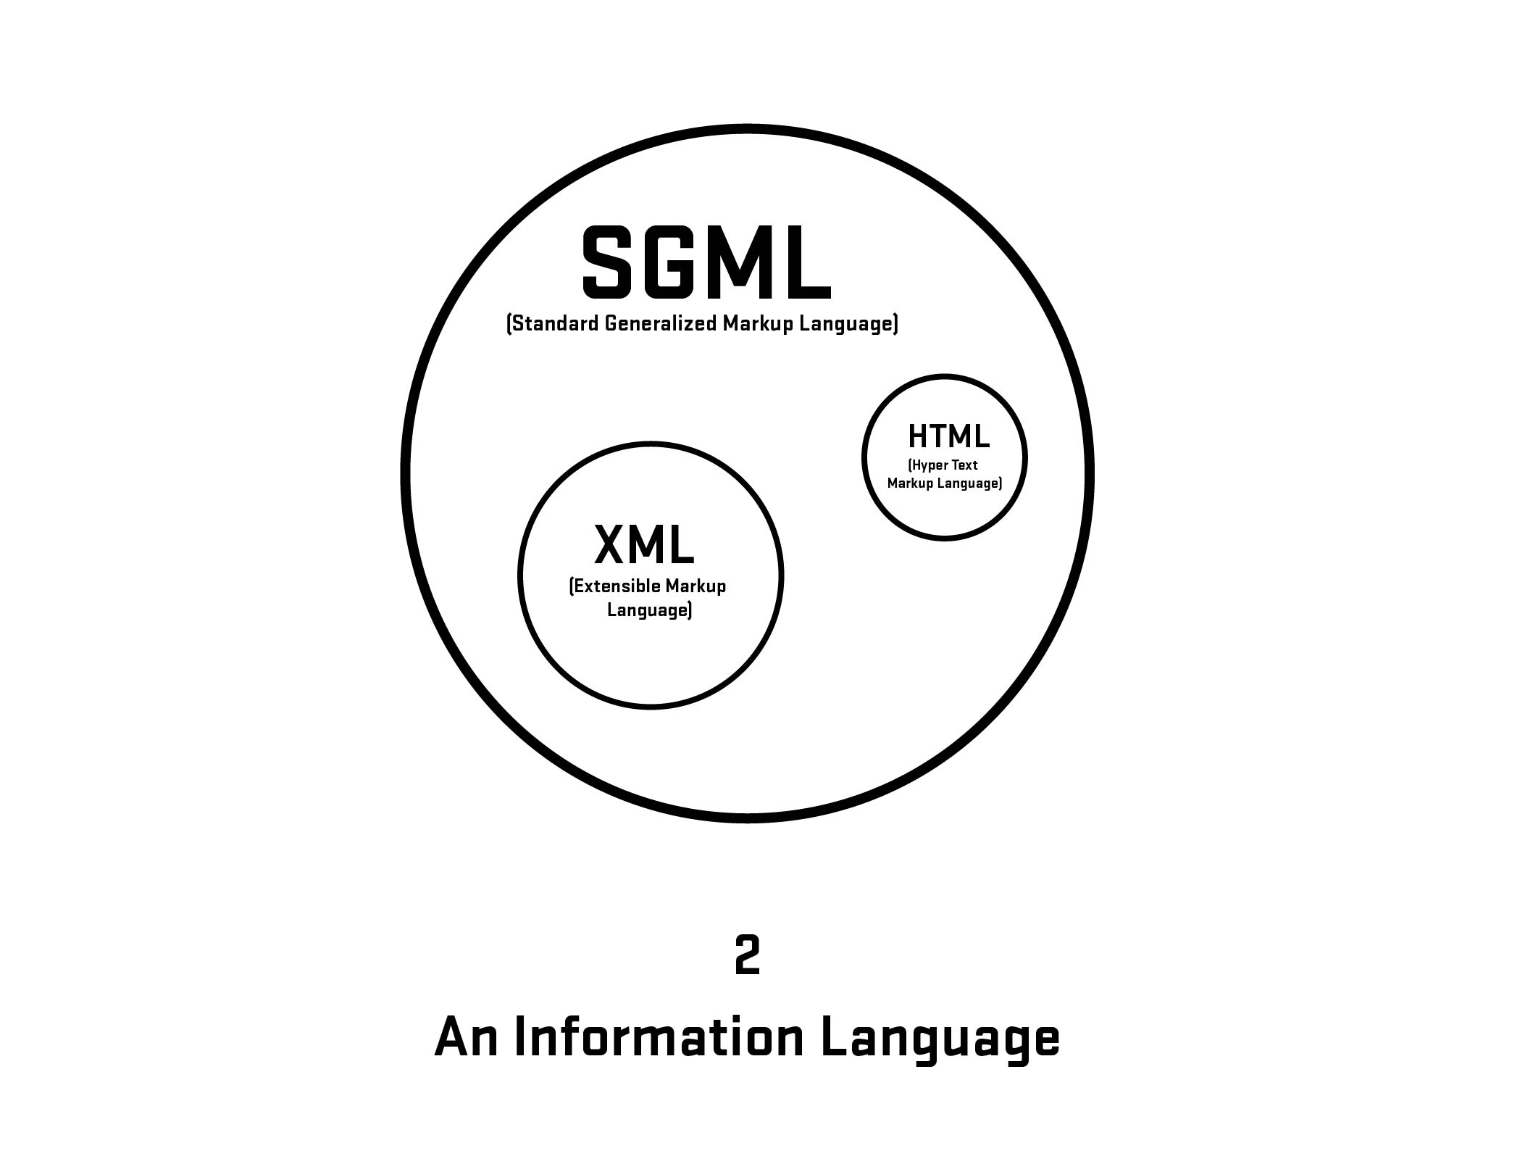
Notes:
28

Slide 29
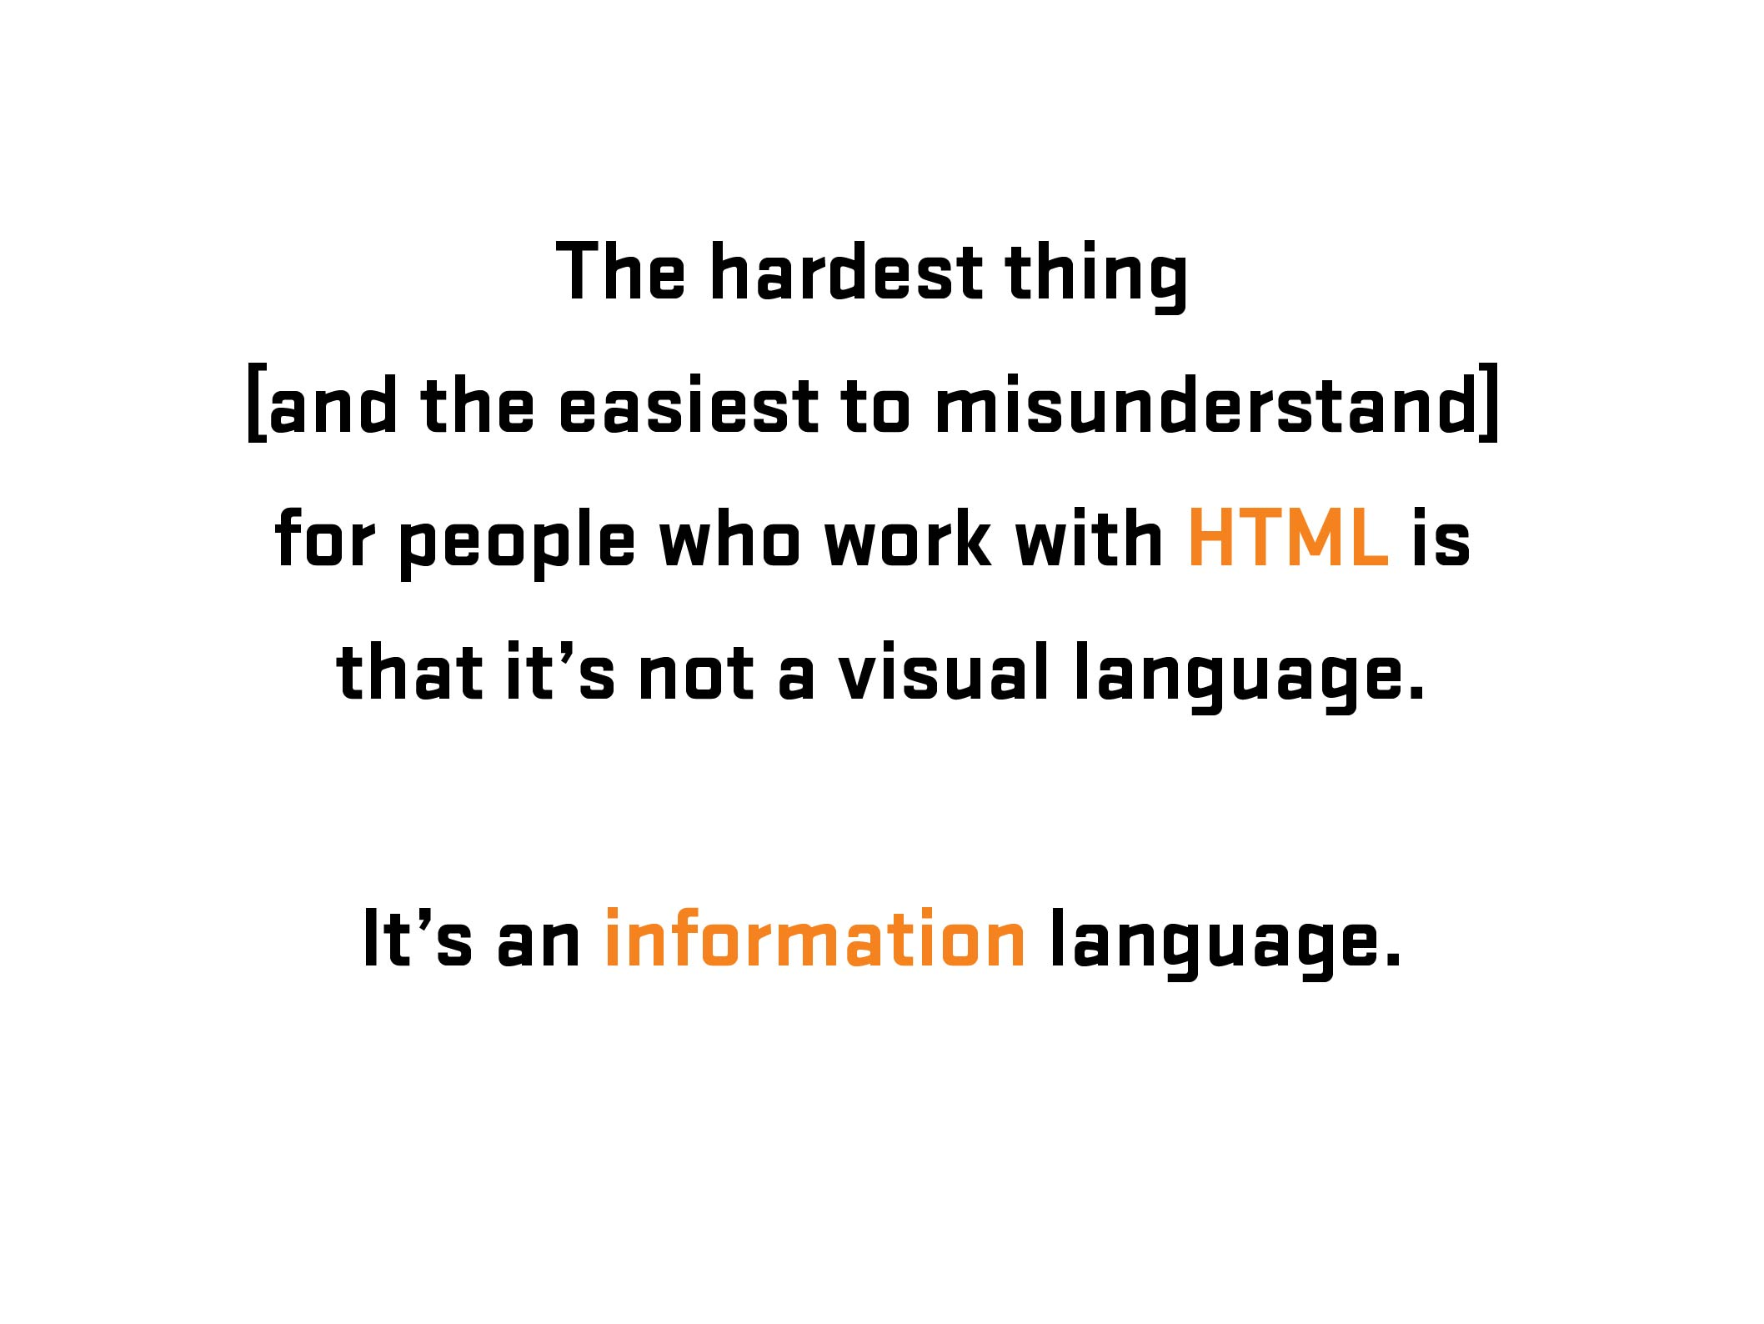
Notes:
29
29

Slide 30

More Information: https://en.wikipedia.org/wiki/Kaieteur_Falls
Notes:
30
Kaiteur Falls, Guyana
30

Slide 31

Notes:
31
Kaiteur Falls, Guyana
31

Slide 32
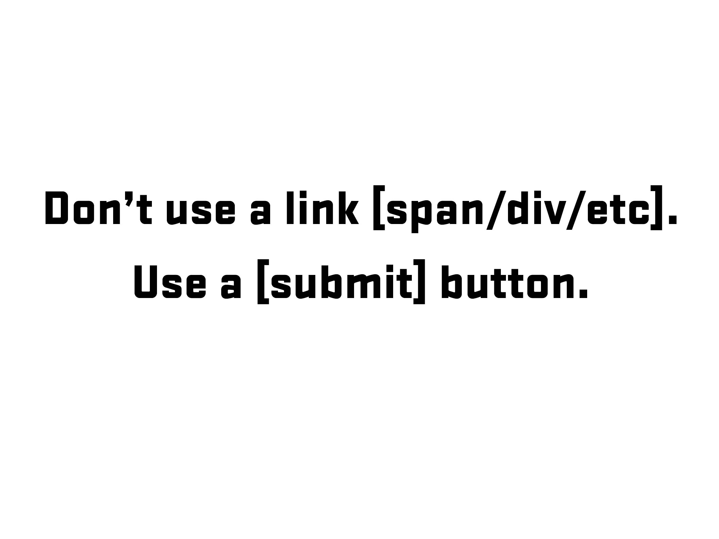

Slide 33
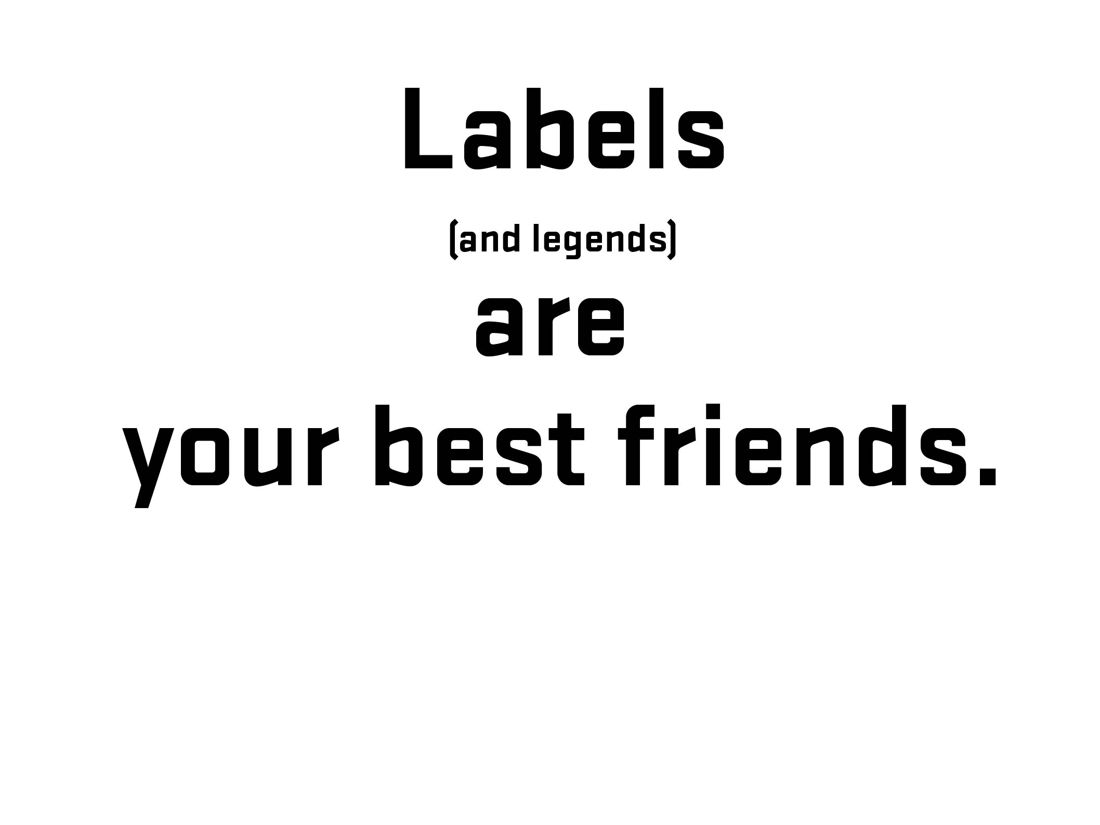

Notes:
33
Before going further – 1) explain what labels are and 2) what is that difference between placeholder and labels (and why that is important)
33

Slide 34
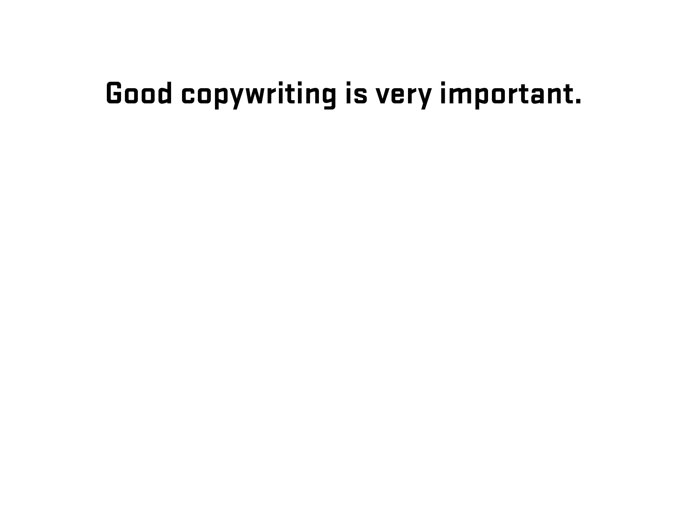
Notes:
34
Diversion – side note about good writing for labels (copywriting)
34

Slide 35
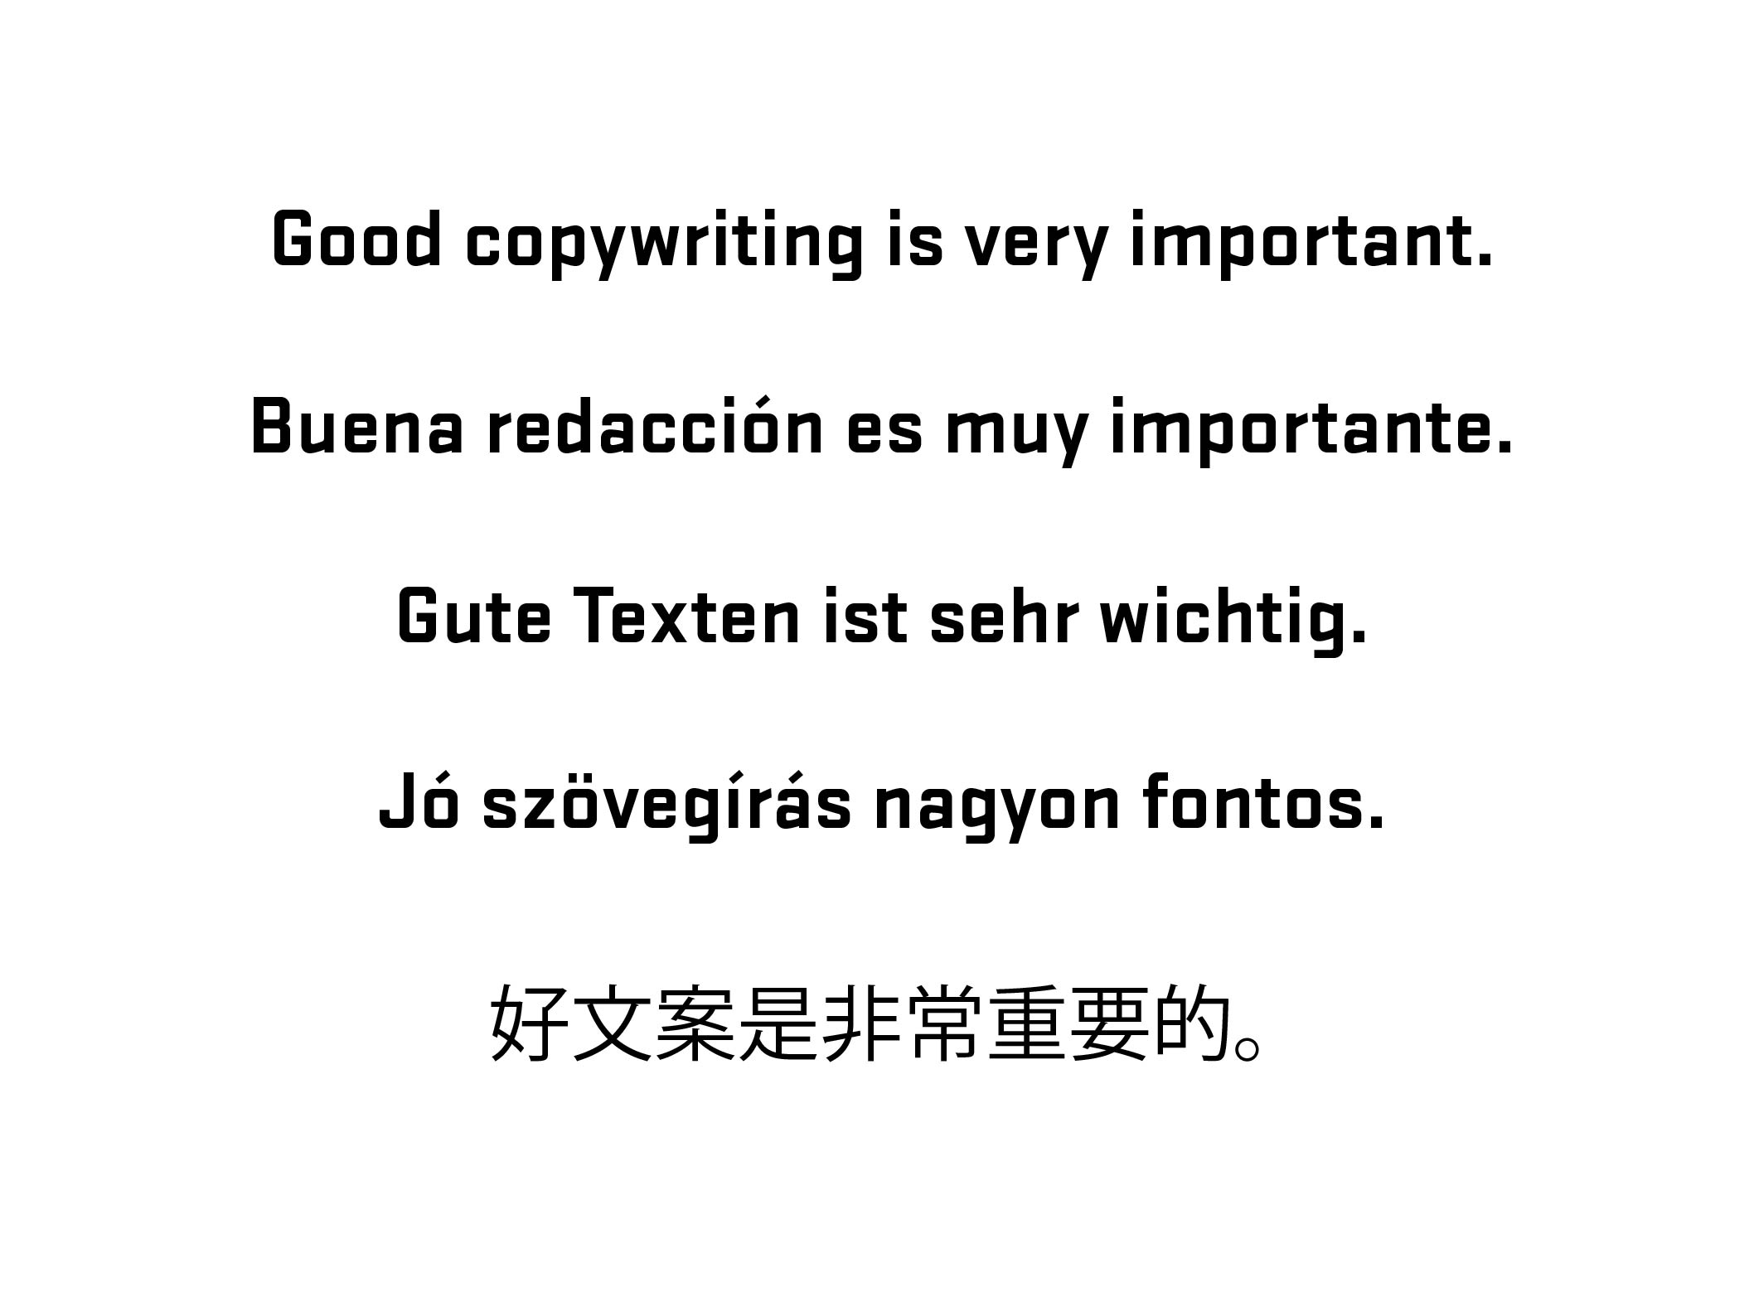
Notes:
35
Diversion – side note about good writing for labels (copywriting)
35

Slide 36
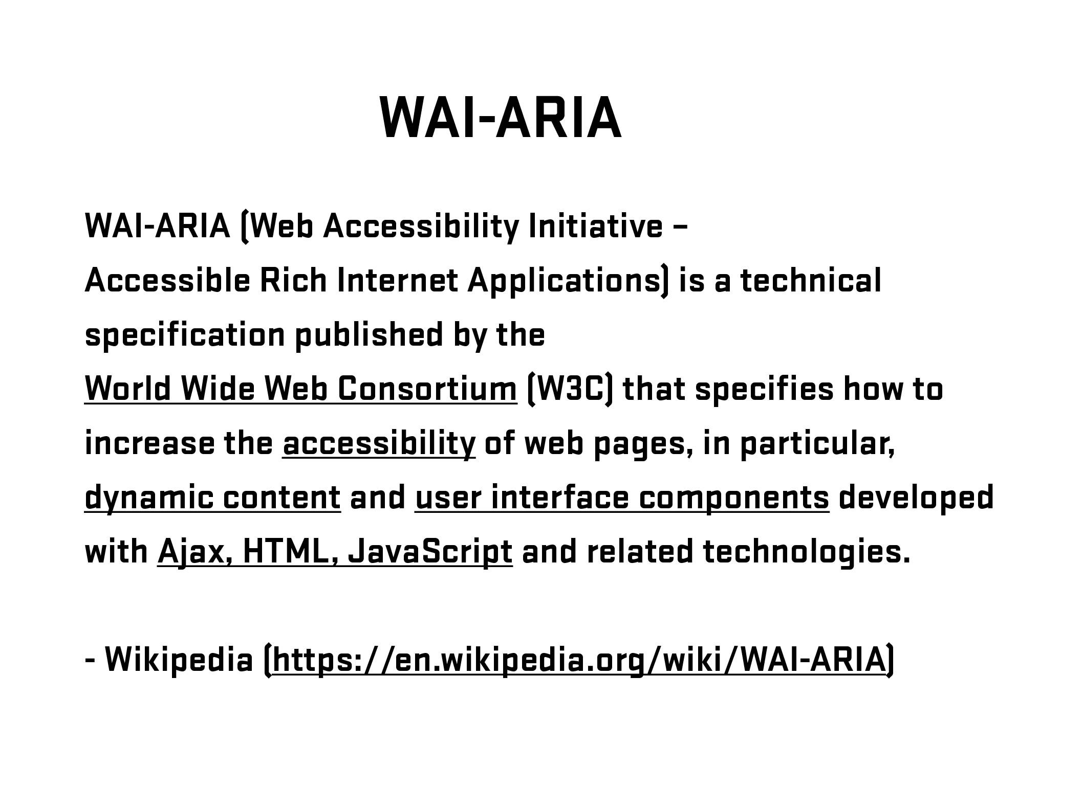
Notes:
36
Brief overview of history/explanation. Go further if needed – refer to W3C.
Need list of resources for audience
36

Slide 37
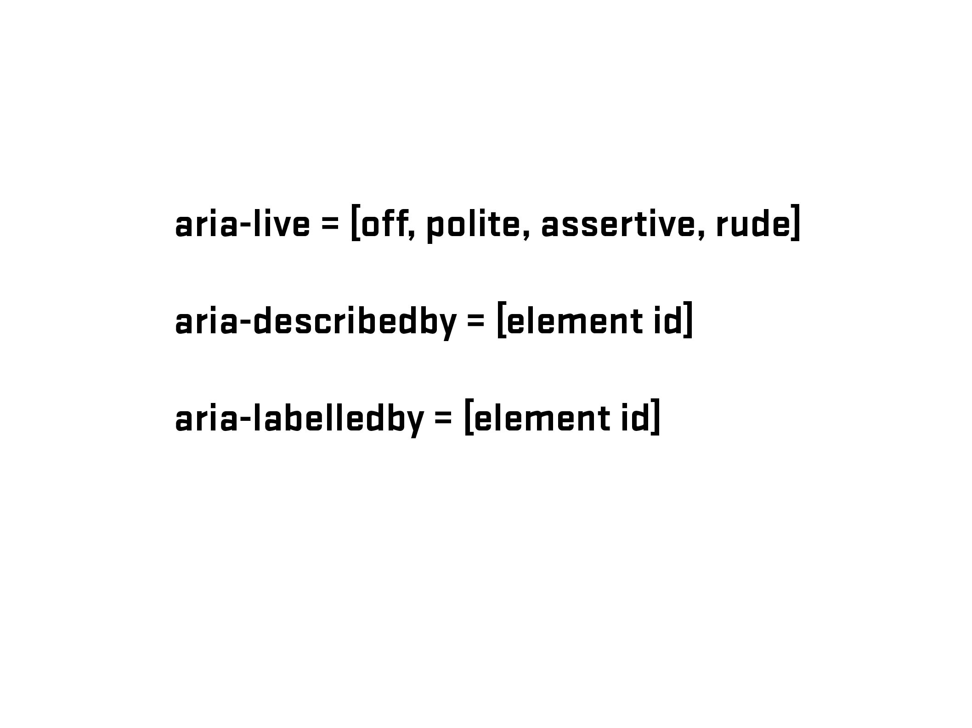
Notes:
37

Slide 38
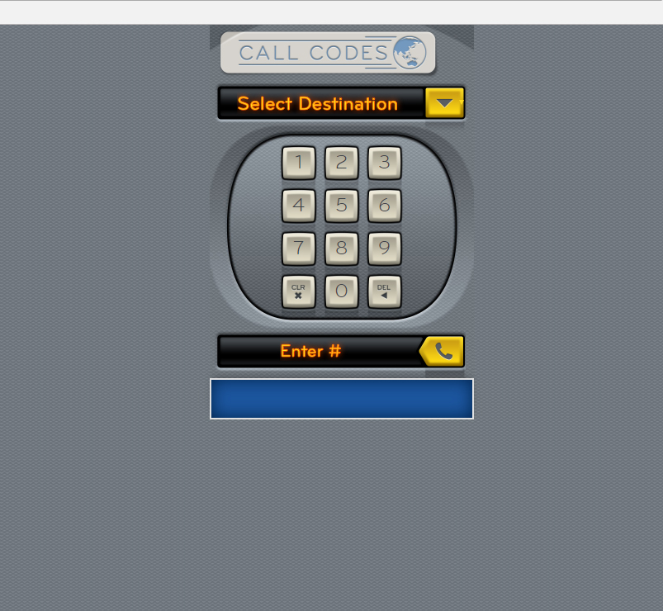

Slide 39
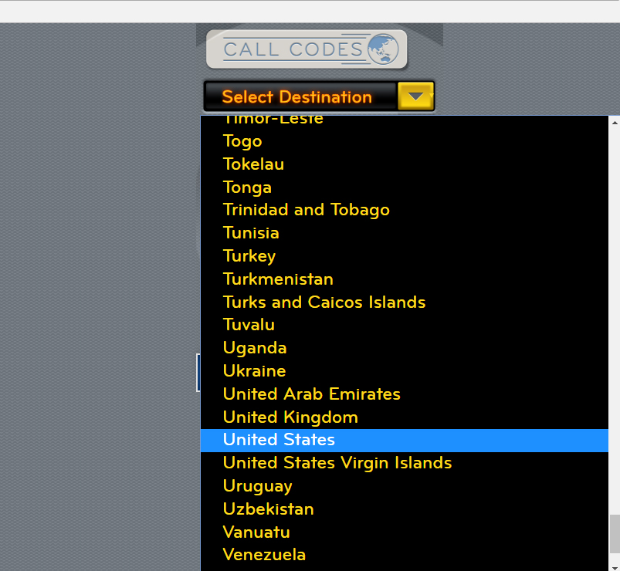

Slide 40
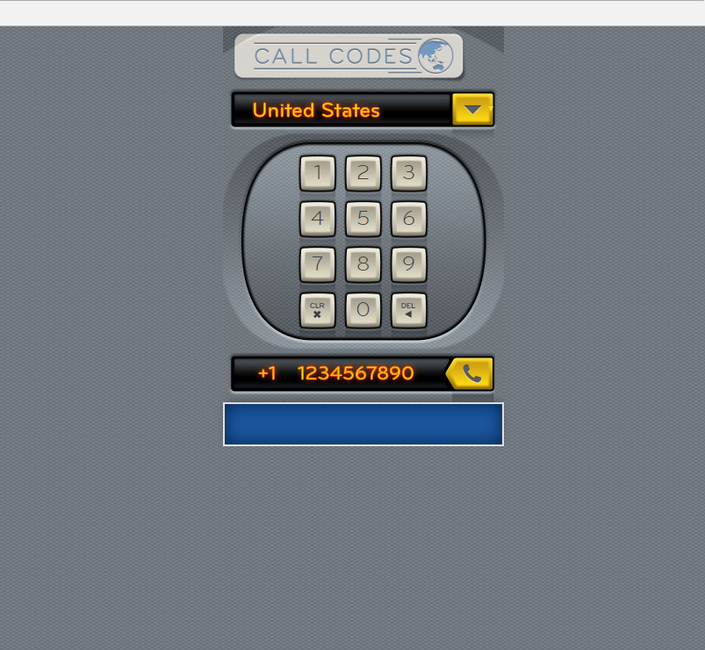

Slide 41
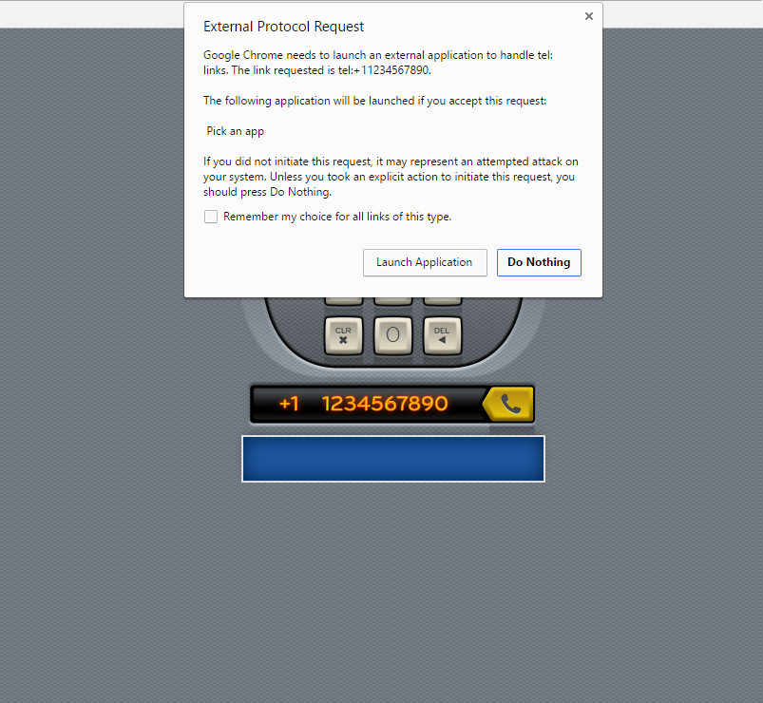

Slide 42
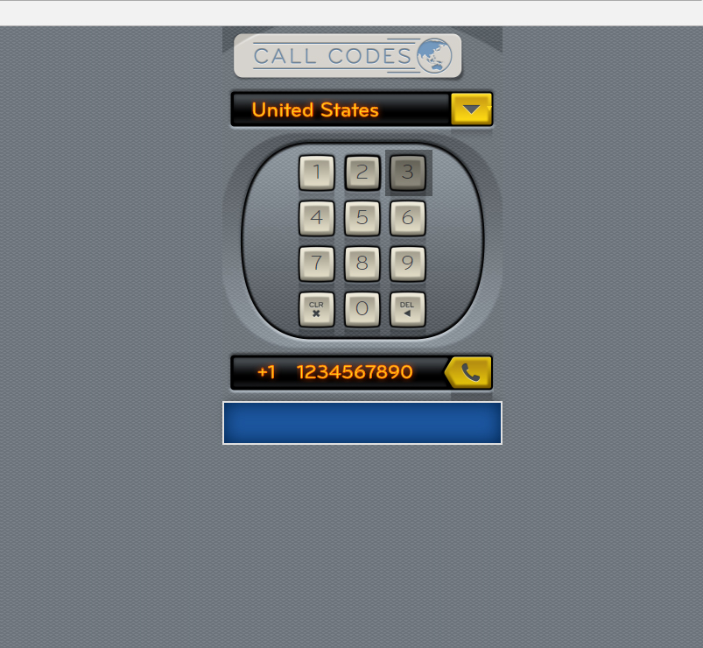
<span>3</span>

Slide 43
<button type="button">3</button>

Slide 44
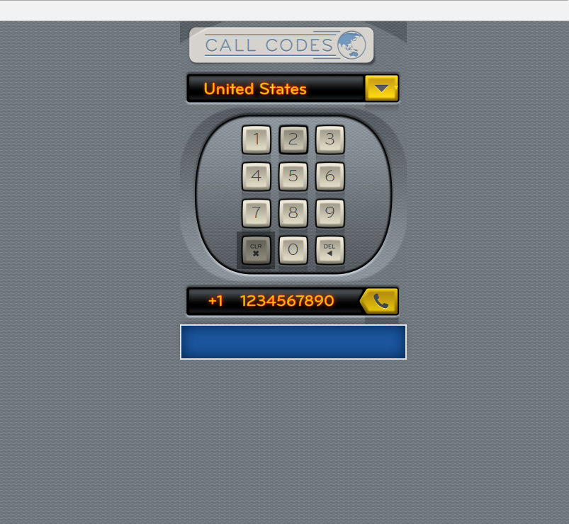
<span class="clearButton"><img src="files/images/icons/icon-clear-key-touch.png" width="17" height="18" alt="Clear"></span>

Slide 45
<input type="reset" class="clearButton" value="Clear Number">

Slide 46
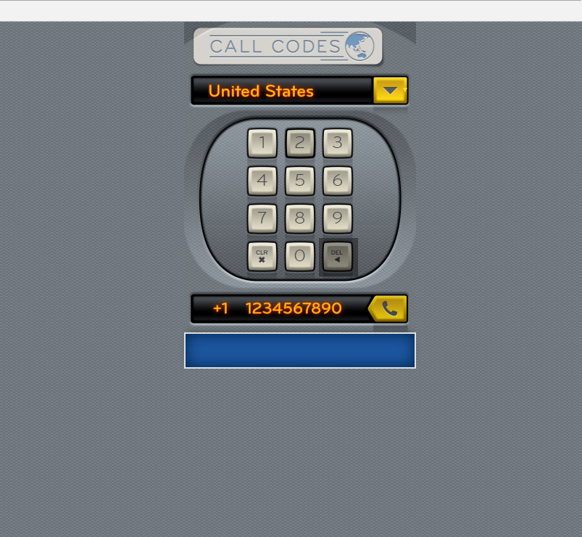
<span class="deleteNumber"><img src="files/images/icons/icon-del-key-touch.png" width="17" height="18" alt="<"></span>

Slide 47
<button type="button" class="deleteNumber">Delete Numbers</button>

Slide 48
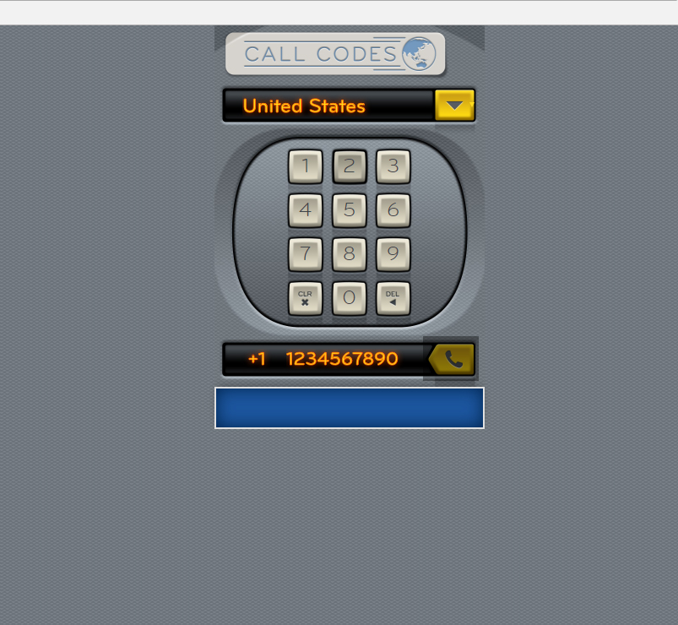
<a href="#" class="callButton ui-link"></a>

Slide 49
<input type="submit" name="call" value="Call Number" class="callButton">

Slide 50
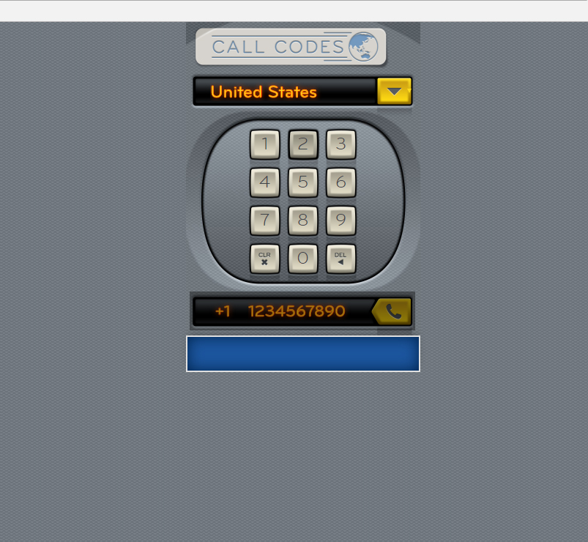
JS - Add aria-live=“polite” when the full number (10 characters) has been reached – indicating number is ready to be called

Slide 51
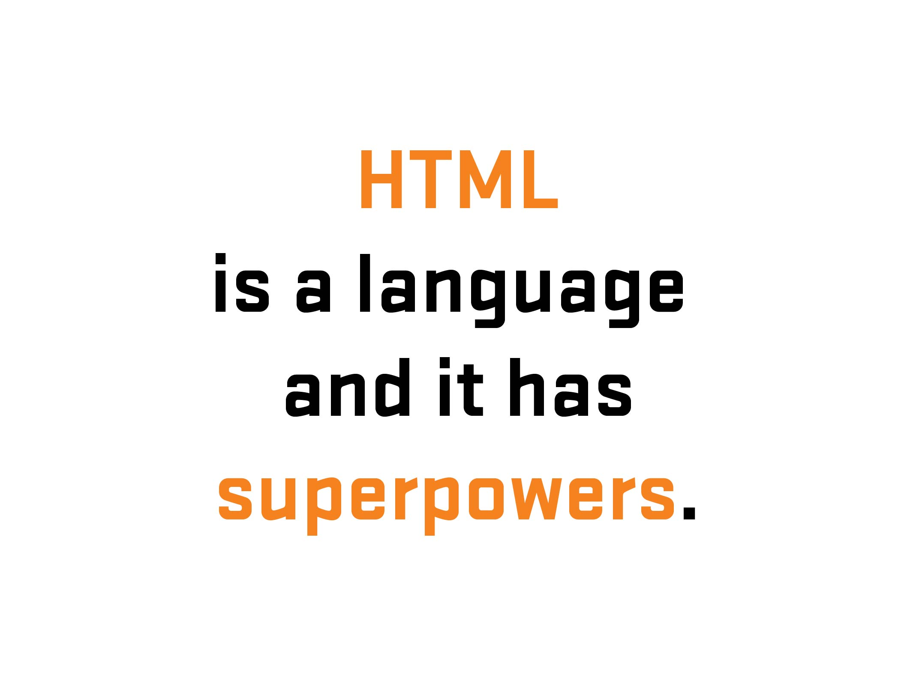

Slide 52
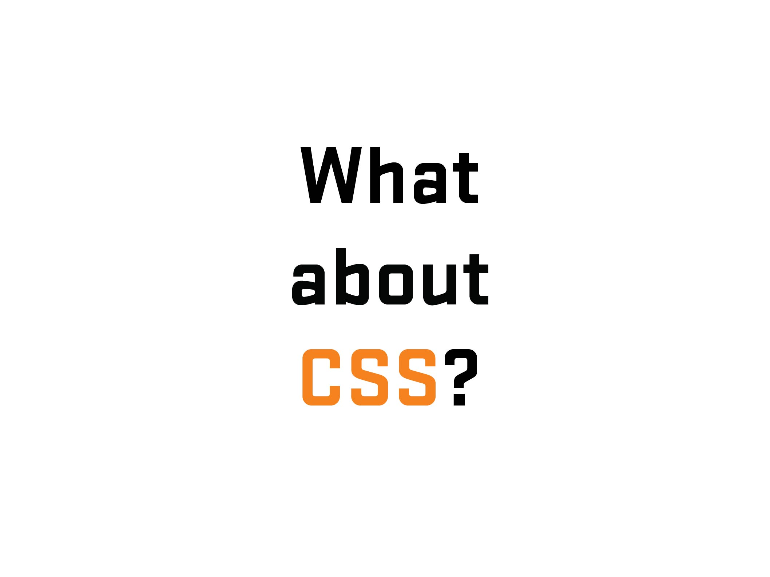
Notes:
52

Slide 53

Notes:
53

Slide 54
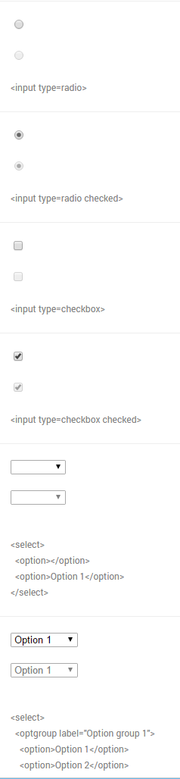
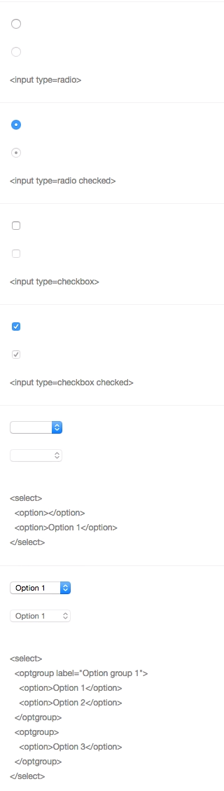
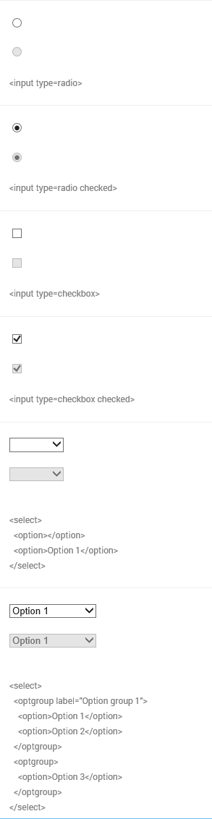

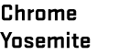

Notes:
54
Differences of form UI’s among browsers/platforms
54

Slide 55
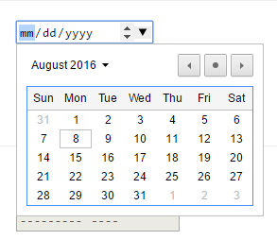



Notes:
55
Another example – Date input (different look/functionality/UI) – Desktop
Go to nativeformelements.com for brief demo
55

Slide 56




Notes:
56
Another example – Date input (different look/functionality/UI) - Mobile
56

Slide 57


Slide 58


Slide 59

Notes:
59
Before going further – 1) explain what labels are and 2) what is that difference between placeholder and labels (and why that is important)
59

Slide 60



Slide 61


Slide 62


Slide 63


Slide 64

Notes:
64
youGo – travel insurance for under 30 crowd/Cover-More
64

Slide 65
Notes:
65
65
youGo/unlucky explanation – Visual (Choice #1)
Form with four set of radio buttons – no submit
(demo form)
Go to youGo site for demo - http://yougotravelinsurance.com.au/

Slide 66

Notes:
66
66
youGo/unlucky explanation – Visual/Code (Choice #1)

Slide 67

Notes:
67
67
youGo/unlucky explanation – Visual/Code (Choice #1)

Slide 68

Notes:
68
68
youGo/unlucky explanation – Visual/Code (Choice #1)

Slide 69

Notes:
69
69
youGo/unlucky explanation – Visual/Code (Choice #1)

Slide 70


Notes:
70
70
youGo/unlucky explanation – Visual/Code (Choice #1)

Slide 71


Slide 72


Slide 73


Slide 74


Slide 75


Slide 76


Slide 77


Slide 78


Slide 79


Slide 80


Slide 81



Slide 82

Notes:
82
Solved problem with two prong/server page approach – one desktop/one mobile. Which is an viable option (see McGrane/adaptive solutions). But at the time, it had hiccups (serving wrong page, etc.). Not a mess but not an ideal (responsive) solution.
82

Slide 83

Notes:
83
If I had a chance, what would I do…
So I wrote some notes…
83

Slide 84


Notes:
84
First thing, change the codebase (responsive/reduced JS/a11y?)
Allowed for direct data input (no JS)
Single code base (responsive)
A11y???
84

Slide 85

Notes:
85
Going back to the base – information language
85

Slide 86

Notes:
86

Slide 87

Notes:
87

Slide 88

Notes:
88

Slide 89

Notes:
89
89

Slide 90

Notes:
90

Slide 91

Notes:
91
No JS in data entry – used for display/toggle
91

Slide 92
.ui-countryselector input[type="radio"]
+ label ~ div.columns {
overflow: hidden;
float: none;
position: absolute;
clip: rect(0,0,0,0);
width: 100%;
height: 0;
margin: 0;
padding: 0;
}
Notes:
92
92

Slide 93
If a region is not selected,
hide related countries
Notes:
93
93

Slide 94
If a region is selected,
show related countries
Notes:
94
94

Slide 95
.ui-countryselector input[type="radio"]:checked
+ label ~ div.columns {
position: static;
height: auto;
}
Notes:
95
95

Slide 96
.ui-countryselector input[type="radio"] + label ~ div.columns { overflow: auto; }
Notes:
96
96

Slide 97

.ui-countryselector input[type="radio"]:checked + label ~ div.columns { float: left; height: 384px; }
Notes:
97
Note – hard to do due to bugs. Adjacent bug in both iOS (“+” didn’t work) and Android (needed fix). Thankfully, fixed in more recent versions.
97

Slide 98

Notes:
98
I found out during QA testing and was able to remove or work around some of the barriers.
98

Slide 99

Notes:
99
No excuse for not testing – getting problems out of the way. For the initial work, even had to test for Android 2.3…But the way, a moment of silence….
99

Slide 100


Slide 101


Slide 102

Notes:
102
102

